Slide 1

Measuring the Shift:
Interlinear Baselines for Quantifying
Translator Intervention in Vector Spaces
Maciej Rapacz
AGH University of Krakow
EADH2026 · Kraków · 16 September 2026
Notes:
KEY POINTS
- intuition, evidence, limits
- method still under evaluation
DETAILED NOTES
Hello. My name is Maciej Rapacz, from AGH University of Krakow.
Today I am going to present a method for quantifying translator intervention
with an interlinear baseline. The method is still being evaluated, so I will
focus on the intuition behind it, the evidence we have so far, and the limits of
that evidence.
[Sources]
- Rapacz, Maciej. “Measuring the Shift: Interlinear Baselines for Quantifying Translator Intervention in Vector Spaces.” EADH2026 accepted abstract.

Slide 2
One passage, several translations
τὸν ἄρτον ἡμῶν τὸν ἐπιούσιον δὸς ἡμῖν σήμερον
Matthew 6:11
Notes:
KEY POINTS
- same source, different choices
- not translation quality
- represent the differences
DETAILED NOTES
Let me begin with one passage from the Greek New Testament: Matthew 6:11.
[click]
The King James Version gives us: “Give us this day our daily bread.” The New
International Version makes only a small change: “Give us today our daily
bread.”
[click]
The New Living Translation moves further: “Give us today the food we need.”
[click]
Other translations choose “appointed bread” or “supersubstantial bread.”
[click]
The Message moves furthest from the familiar formulation: “Keep us alive with
three square meals.”
The source passage is the same, but the translators make different lexical,
syntactic, interpretive, and cultural decisions. I am not asking which version
is best. I am asking whether we can represent the differences between them.
[Sources]
- Matthew 6:11, Greek New Testament; King James Version, New International Version, New Living Translation, Literal Standard Version, Douay-Rheims Bible, and The Message.

Slide 3
One passage, several translations
τὸν ἄρτον ἡμῶν τὸν ἐπιούσιον δὸς ἡμῖν σήμερον
Matthew 6:11
Give us this day our daily bread.
King James Version
Give us today our daily bread.
New International Version
Notes:
KEY POINTS
- same source, different choices
- not translation quality
- represent the differences
DETAILED NOTES
Let me begin with one passage from the Greek New Testament: Matthew 6:11.
[click]
The King James Version gives us: “Give us this day our daily bread.” The New
International Version makes only a small change: “Give us today our daily
bread.”
[click]
The New Living Translation moves further: “Give us today the food we need.”
[click]
Other translations choose “appointed bread” or “supersubstantial bread.”
[click]
The Message moves furthest from the familiar formulation: “Keep us alive with
three square meals.”
The source passage is the same, but the translators make different lexical,
syntactic, interpretive, and cultural decisions. I am not asking which version
is best. I am asking whether we can represent the differences between them.
[Sources]
- Matthew 6:11, Greek New Testament; King James Version, New International Version, New Living Translation, Literal Standard Version, Douay-Rheims Bible, and The Message.

Slide 4
One passage, several translations
τὸν ἄρτον ἡμῶν τὸν ἐπιούσιον δὸς ἡμῖν σήμερον
Matthew 6:11
Give us this day our daily bread.
King James Version
Give us today our daily bread.
New International Version
Give us today the food we need.
New Living Translation
Notes:
KEY POINTS
- same source, different choices
- not translation quality
- represent the differences
DETAILED NOTES
Let me begin with one passage from the Greek New Testament: Matthew 6:11.
[click]
The King James Version gives us: “Give us this day our daily bread.” The New
International Version makes only a small change: “Give us today our daily
bread.”
[click]
The New Living Translation moves further: “Give us today the food we need.”
[click]
Other translations choose “appointed bread” or “supersubstantial bread.”
[click]
The Message moves furthest from the familiar formulation: “Keep us alive with
three square meals.”
The source passage is the same, but the translators make different lexical,
syntactic, interpretive, and cultural decisions. I am not asking which version
is best. I am asking whether we can represent the differences between them.
[Sources]
- Matthew 6:11, Greek New Testament; King James Version, New International Version, New Living Translation, Literal Standard Version, Douay-Rheims Bible, and The Message.

Slide 5
One passage, several translations
τὸν ἄρτον ἡμῶν τὸν ἐπιούσιον δὸς ἡμῖν σήμερον
Matthew 6:11
Give us this day our daily bread.
King James Version
Give us today our daily bread.
New International Version
Give us today the food we need.
New Living Translation
Give us today our appointed bread.
Literal Standard Version
Give us this day our supersubstantial bread.
Douay-Rheims Bible
Notes:
KEY POINTS
- same source, different choices
- not translation quality
- represent the differences
DETAILED NOTES
Let me begin with one passage from the Greek New Testament: Matthew 6:11.
[click]
The King James Version gives us: “Give us this day our daily bread.” The New
International Version makes only a small change: “Give us today our daily
bread.”
[click]
The New Living Translation moves further: “Give us today the food we need.”
[click]
Other translations choose “appointed bread” or “supersubstantial bread.”
[click]
The Message moves furthest from the familiar formulation: “Keep us alive with
three square meals.”
The source passage is the same, but the translators make different lexical,
syntactic, interpretive, and cultural decisions. I am not asking which version
is best. I am asking whether we can represent the differences between them.
[Sources]
- Matthew 6:11, Greek New Testament; King James Version, New International Version, New Living Translation, Literal Standard Version, Douay-Rheims Bible, and The Message.

Slide 6
One passage, several translations
τὸν ἄρτον ἡμῶν τὸν ἐπιούσιον δὸς ἡμῖν σήμερον
Matthew 6:11
Give us this day our daily bread.
King James Version
Give us today our daily bread.
New International Version
Give us today the food we need.
New Living Translation
Give us today our appointed bread.
Literal Standard Version
Give us this day our supersubstantial bread.
Douay-Rheims Bible
Keep us alive with three square meals.
The Message
Notes:
KEY POINTS
- same source, different choices
- not translation quality
- represent the differences
DETAILED NOTES
Let me begin with one passage from the Greek New Testament: Matthew 6:11.
[click]
The King James Version gives us: “Give us this day our daily bread.” The New
International Version makes only a small change: “Give us today our daily
bread.”
[click]
The New Living Translation moves further: “Give us today the food we need.”
[click]
Other translations choose “appointed bread” or “supersubstantial bread.”
[click]
The Message moves furthest from the familiar formulation: “Keep us alive with
three square meals.”
The source passage is the same, but the translators make different lexical,
syntactic, interpretive, and cultural decisions. I am not asking which version
is best. I am asking whether we can represent the differences between them.
[Sources]
- Matthew 6:11, Greek New Testament; King James Version, New International Version, New Living Translation, Literal Standard Version, Douay-Rheims Bible, and The Message.

Slide 7
Intervention in translation
“From the point of view of the target literature,
all translation implies a degree of manipulation
of the source text for a certain purpose.”
Theo Hermans · 1985
Notes:
KEY POINTS
- purposeful rewriting
- manipulation is theoretical
- add, omit, explain, reinterpret
DETAILED NOTES
This is not a new observation. Translation Studies has long treated
translation as purposeful rewriting.
Theo Hermans, writing within the Manipulation School, says that translation
implies a degree of manipulation of the source text for a certain purpose.
Here, manipulation is a theoretical term, not an accusation.
[click]
A translator may add, omit, simplify, explain, or choose a particular
interpretation. I use *translator intervention* as an umbrella term for these
decisions beyond the obligatory change of language.
[Sources]
- Hermans, Theo, ed. 1985. The Manipulation of Literature. Croom Helm, p. 11.

Slide 8
Intervention in translation
“From the point of view of the target literature,
all translation implies a degree of manipulation
of the source text for a certain purpose.”
Theo Hermans · 1985
add · omit · simplify · explain · reinterpret
Notes:
KEY POINTS
- purposeful rewriting
- manipulation is theoretical
- add, omit, explain, reinterpret
DETAILED NOTES
This is not a new observation. Translation Studies has long treated
translation as purposeful rewriting.
Theo Hermans, writing within the Manipulation School, says that translation
implies a degree of manipulation of the source text for a certain purpose.
Here, manipulation is a theoretical term, not an accusation.
[click]
A translator may add, omit, simplify, explain, or choose a particular
interpretation. I use *translator intervention* as an umbrella term for these
decisions beyond the obligatory change of language.
[Sources]
- Hermans, Theo, ed. 1985. The Manipulation of Literature. Croom Helm, p. 11.

Slide 9
What we are looking for
Notes:
KEY POINTS
- rich existing terminology
- no new taxonomy
- no predefined labels
- not discrete
- not corpus-relative
- one passage is enough
DETAILED NOTES
Translation Studies does not lack terminology for such phenomena.
[click]
Different traditions describe procedures, shifts, strategies, techniques, and
corpus-level tendencies. These terms are not interchangeable: they refer to
textual solutions, structural differences, problem-solving processes, and
patterns across corpora.
I am not proposing another taxonomy. I want a representation with four
properties.
[click]
First, its construction should be **taxonomy-independent**. We should not have
to select one inventory of operations before measuring anything. The existing
taxonomies can still help us interpret the result.
[click]
Second, it should be **continuous**. A translation need not occupy one discrete
category; its position, magnitude, and direction can vary.
[click]
Third, it should be **corpus-independent**. The representation should not be
defined relative to a comparison corpus.
[click]
Fourth, it should operate at **passage level**. One passage is enough; we do
not need a whole text before constructing the representation.
[Sources]
- Vinay, Jean-Paul, and Jean Darbelnet. 1995. Comparative Stylistics of French and English.
- Catford, J. C. 1965. A Linguistic Theory of Translation.
- Chesterman, Andrew. 1997. Memes of Translation.
- Molina, Lucía, and Amparo Hurtado Albir. 2002. “Translation Techniques Revisited.” Meta 47(4).
- Blum-Kulka, Shoshana; Mona Baker; and Sara Laviosa, on explicitation and corpus-level translation tendencies.
- Rapacz, Maciej. EADH2026 accepted abstract, research-design framing.

Slide 10
What we are looking for
Vinay & Darbelnet
procedures
borrowing · calque · literal translation · transposition
modulation · equivalence · adaptation
Catford
shifts
level · structure · class · unit/rank · intra-system
Chesterman
strategies
syntactic · semantic · pragmatic · explicitness
cultural filtering · information change · paraphrase
Molina & Hurtado Albir
techniques
amplification/reduction · compensation · description
generalisation/particularisation · discursive creation · variation
Blum-Kulka · Baker · Laviosa
tendencies / “universals”
explicitation · simplification · normalisation · levelling-out
Notes:
KEY POINTS
- rich existing terminology
- no new taxonomy
- no predefined labels
- not discrete
- not corpus-relative
- one passage is enough
DETAILED NOTES
Translation Studies does not lack terminology for such phenomena.
[click]
Different traditions describe procedures, shifts, strategies, techniques, and
corpus-level tendencies. These terms are not interchangeable: they refer to
textual solutions, structural differences, problem-solving processes, and
patterns across corpora.
I am not proposing another taxonomy. I want a representation with four
properties.
[click]
First, its construction should be **taxonomy-independent**. We should not have
to select one inventory of operations before measuring anything. The existing
taxonomies can still help us interpret the result.
[click]
Second, it should be **continuous**. A translation need not occupy one discrete
category; its position, magnitude, and direction can vary.
[click]
Third, it should be **corpus-independent**. The representation should not be
defined relative to a comparison corpus.
[click]
Fourth, it should operate at **passage level**. One passage is enough; we do
not need a whole text before constructing the representation.
[Sources]
- Vinay, Jean-Paul, and Jean Darbelnet. 1995. Comparative Stylistics of French and English.
- Catford, J. C. 1965. A Linguistic Theory of Translation.
- Chesterman, Andrew. 1997. Memes of Translation.
- Molina, Lucía, and Amparo Hurtado Albir. 2002. “Translation Techniques Revisited.” Meta 47(4).
- Blum-Kulka, Shoshana; Mona Baker; and Sara Laviosa, on explicitation and corpus-level translation tendencies.
- Rapacz, Maciej. EADH2026 accepted abstract, research-design framing.

Slide 11
What we are looking for
Vinay & Darbelnet
procedures
borrowing · calque · literal translation · transposition
modulation · equivalence · adaptation
Catford
shifts
level · structure · class · unit/rank · intra-system
Chesterman
strategies
syntactic · semantic · pragmatic · explicitness
cultural filtering · information change · paraphrase
Molina & Hurtado Albir
techniques
amplification/reduction · compensation · description
generalisation/particularisation · discursive creation · variation
Blum-Kulka · Baker · Laviosa
tendencies / “universals”
explicitation · simplification · normalisation · levelling-out
taxonomy-independent
no predefined labels
Notes:
KEY POINTS
- rich existing terminology
- no new taxonomy
- no predefined labels
- not discrete
- not corpus-relative
- one passage is enough
DETAILED NOTES
Translation Studies does not lack terminology for such phenomena.
[click]
Different traditions describe procedures, shifts, strategies, techniques, and
corpus-level tendencies. These terms are not interchangeable: they refer to
textual solutions, structural differences, problem-solving processes, and
patterns across corpora.
I am not proposing another taxonomy. I want a representation with four
properties.
[click]
First, its construction should be **taxonomy-independent**. We should not have
to select one inventory of operations before measuring anything. The existing
taxonomies can still help us interpret the result.
[click]
Second, it should be **continuous**. A translation need not occupy one discrete
category; its position, magnitude, and direction can vary.
[click]
Third, it should be **corpus-independent**. The representation should not be
defined relative to a comparison corpus.
[click]
Fourth, it should operate at **passage level**. One passage is enough; we do
not need a whole text before constructing the representation.
[Sources]
- Vinay, Jean-Paul, and Jean Darbelnet. 1995. Comparative Stylistics of French and English.
- Catford, J. C. 1965. A Linguistic Theory of Translation.
- Chesterman, Andrew. 1997. Memes of Translation.
- Molina, Lucía, and Amparo Hurtado Albir. 2002. “Translation Techniques Revisited.” Meta 47(4).
- Blum-Kulka, Shoshana; Mona Baker; and Sara Laviosa, on explicitation and corpus-level translation tendencies.
- Rapacz, Maciej. EADH2026 accepted abstract, research-design framing.

Slide 12
What we are looking for
Vinay & Darbelnet
procedures
borrowing · calque · literal translation · transposition
modulation · equivalence · adaptation
Catford
shifts
level · structure · class · unit/rank · intra-system
Chesterman
strategies
syntactic · semantic · pragmatic · explicitness
cultural filtering · information change · paraphrase
Molina & Hurtado Albir
techniques
amplification/reduction · compensation · description
generalisation/particularisation · discursive creation · variation
Blum-Kulka · Baker · Laviosa
tendencies / “universals”
explicitation · simplification · normalisation · levelling-out
taxonomy-independent
continuous
no predefined labels
not discrete
Notes:
KEY POINTS
- rich existing terminology
- no new taxonomy
- no predefined labels
- not discrete
- not corpus-relative
- one passage is enough
DETAILED NOTES
Translation Studies does not lack terminology for such phenomena.
[click]
Different traditions describe procedures, shifts, strategies, techniques, and
corpus-level tendencies. These terms are not interchangeable: they refer to
textual solutions, structural differences, problem-solving processes, and
patterns across corpora.
I am not proposing another taxonomy. I want a representation with four
properties.
[click]
First, its construction should be **taxonomy-independent**. We should not have
to select one inventory of operations before measuring anything. The existing
taxonomies can still help us interpret the result.
[click]
Second, it should be **continuous**. A translation need not occupy one discrete
category; its position, magnitude, and direction can vary.
[click]
Third, it should be **corpus-independent**. The representation should not be
defined relative to a comparison corpus.
[click]
Fourth, it should operate at **passage level**. One passage is enough; we do
not need a whole text before constructing the representation.
[Sources]
- Vinay, Jean-Paul, and Jean Darbelnet. 1995. Comparative Stylistics of French and English.
- Catford, J. C. 1965. A Linguistic Theory of Translation.
- Chesterman, Andrew. 1997. Memes of Translation.
- Molina, Lucía, and Amparo Hurtado Albir. 2002. “Translation Techniques Revisited.” Meta 47(4).
- Blum-Kulka, Shoshana; Mona Baker; and Sara Laviosa, on explicitation and corpus-level translation tendencies.
- Rapacz, Maciej. EADH2026 accepted abstract, research-design framing.

Slide 13
What we are looking for
Vinay & Darbelnet
procedures
borrowing · calque · literal translation · transposition
modulation · equivalence · adaptation
Catford
shifts
level · structure · class · unit/rank · intra-system
Chesterman
strategies
syntactic · semantic · pragmatic · explicitness
cultural filtering · information change · paraphrase
Molina & Hurtado Albir
techniques
amplification/reduction · compensation · description
generalisation/particularisation · discursive creation · variation
Blum-Kulka · Baker · Laviosa
tendencies / “universals”
explicitation · simplification · normalisation · levelling-out
taxonomy-independent
continuous
corpus-independent
no predefined labels
not discrete
not corpus-relative
Notes:
KEY POINTS
- rich existing terminology
- no new taxonomy
- no predefined labels
- not discrete
- not corpus-relative
- one passage is enough
DETAILED NOTES
Translation Studies does not lack terminology for such phenomena.
[click]
Different traditions describe procedures, shifts, strategies, techniques, and
corpus-level tendencies. These terms are not interchangeable: they refer to
textual solutions, structural differences, problem-solving processes, and
patterns across corpora.
I am not proposing another taxonomy. I want a representation with four
properties.
[click]
First, its construction should be **taxonomy-independent**. We should not have
to select one inventory of operations before measuring anything. The existing
taxonomies can still help us interpret the result.
[click]
Second, it should be **continuous**. A translation need not occupy one discrete
category; its position, magnitude, and direction can vary.
[click]
Third, it should be **corpus-independent**. The representation should not be
defined relative to a comparison corpus.
[click]
Fourth, it should operate at **passage level**. One passage is enough; we do
not need a whole text before constructing the representation.
[Sources]
- Vinay, Jean-Paul, and Jean Darbelnet. 1995. Comparative Stylistics of French and English.
- Catford, J. C. 1965. A Linguistic Theory of Translation.
- Chesterman, Andrew. 1997. Memes of Translation.
- Molina, Lucía, and Amparo Hurtado Albir. 2002. “Translation Techniques Revisited.” Meta 47(4).
- Blum-Kulka, Shoshana; Mona Baker; and Sara Laviosa, on explicitation and corpus-level translation tendencies.
- Rapacz, Maciej. EADH2026 accepted abstract, research-design framing.

Slide 14
What we are looking for
Vinay & Darbelnet
procedures
borrowing · calque · literal translation · transposition
modulation · equivalence · adaptation
Catford
shifts
level · structure · class · unit/rank · intra-system
Chesterman
strategies
syntactic · semantic · pragmatic · explicitness
cultural filtering · information change · paraphrase
Molina & Hurtado Albir
techniques
amplification/reduction · compensation · description
generalisation/particularisation · discursive creation · variation
Blum-Kulka · Baker · Laviosa
tendencies / “universals”
explicitation · simplification · normalisation · levelling-out
taxonomy-independent
continuous
corpus-independent
passage-level
no predefined labels
not discrete
not corpus-relative
one passage is enough
Notes:
KEY POINTS
- rich existing terminology
- no new taxonomy
- no predefined labels
- not discrete
- not corpus-relative
- one passage is enough
DETAILED NOTES
Translation Studies does not lack terminology for such phenomena.
[click]
Different traditions describe procedures, shifts, strategies, techniques, and
corpus-level tendencies. These terms are not interchangeable: they refer to
textual solutions, structural differences, problem-solving processes, and
patterns across corpora.
I am not proposing another taxonomy. I want a representation with four
properties.
[click]
First, its construction should be **taxonomy-independent**. We should not have
to select one inventory of operations before measuring anything. The existing
taxonomies can still help us interpret the result.
[click]
Second, it should be **continuous**. A translation need not occupy one discrete
category; its position, magnitude, and direction can vary.
[click]
Third, it should be **corpus-independent**. The representation should not be
defined relative to a comparison corpus.
[click]
Fourth, it should operate at **passage level**. One passage is enough; we do
not need a whole text before constructing the representation.
[Sources]
- Vinay, Jean-Paul, and Jean Darbelnet. 1995. Comparative Stylistics of French and English.
- Catford, J. C. 1965. A Linguistic Theory of Translation.
- Chesterman, Andrew. 1997. Memes of Translation.
- Molina, Lucía, and Amparo Hurtado Albir. 2002. “Translation Techniques Revisited.” Meta 47(4).
- Blum-Kulka, Shoshana; Mona Baker; and Sara Laviosa, on explicitation and corpus-level translation tendencies.
- Rapacz, Maciej. EADH2026 accepted abstract, research-design framing.

Slide 15
Literary translation
Notes:
KEY POINTS
- source and literary text
- texts as points
DETAILED NOTES
The intuition begins with a simple geometric picture.
[click]
We have a source text and a literary translation.
[click]
Imagine that both texts can be represented as points in a shared conceptual
space.
[click]
We can now leave the text behind and keep only the two points.
[click]
Translation then becomes a displacement between these points.
[Sources]
- Rapacz, Maciej. EADH2026 accepted abstract, method intuition.

Slide 16
Literary translation
Ἐγένετο ἄνθρωπος ἀπεσταλμένος…
There came a man who was sent…
Notes:
KEY POINTS
- source and literary text
- texts as points
DETAILED NOTES
The intuition begins with a simple geometric picture.
[click]
We have a source text and a literary translation.
[click]
Imagine that both texts can be represented as points in a shared conceptual
space.
[click]
We can now leave the text behind and keep only the two points.
[click]
Translation then becomes a displacement between these points.
[Sources]
- Rapacz, Maciej. EADH2026 accepted abstract, method intuition.

Slide 17
Literary translation
Ἐγένετο ἄνθρωπος ἀπεσταλμένος…
There came a man who was sent…
source
literary
Notes:
KEY POINTS
- source and literary text
- texts as points
DETAILED NOTES
The intuition begins with a simple geometric picture.
[click]
We have a source text and a literary translation.
[click]
Imagine that both texts can be represented as points in a shared conceptual
space.
[click]
We can now leave the text behind and keep only the two points.
[click]
Translation then becomes a displacement between these points.
[Sources]
- Rapacz, Maciej. EADH2026 accepted abstract, method intuition.

Slide 18
Literary translation
source
literary
Notes:
KEY POINTS
- source and literary text
- texts as points
DETAILED NOTES
The intuition begins with a simple geometric picture.
[click]
We have a source text and a literary translation.
[click]
Imagine that both texts can be represented as points in a shared conceptual
space.
[click]
We can now leave the text behind and keep only the two points.
[click]
Translation then becomes a displacement between these points.
[Sources]
- Rapacz, Maciej. EADH2026 accepted abstract, method intuition.

Slide 19
Literary translation
source
literary
Notes:
KEY POINTS
- source and literary text
- texts as points
DETAILED NOTES
The intuition begins with a simple geometric picture.
[click]
We have a source text and a literary translation.
[click]
Imagine that both texts can be represented as points in a shared conceptual
space.
[click]
We can now leave the text behind and keep only the two points.
[click]
Translation then becomes a displacement between these points.
[Sources]
- Rapacz, Maciej. EADH2026 accepted abstract, method intuition.

Slide 20
Literary translation as algebraic translation
source
literary
Notes:
KEY POINTS
- displacement in embedding space
- language change plus intervention
- missing third point
DETAILED NOTES
That displacement combines at least two effects.
[click]
It contains the obligatory change of language, and it contains the
restructuring and interpretation involved in producing this particular
translation.
[click]
To isolate intervention, I need an intermediate target-language point where
restructuring is deliberately constrained.
[click through the two component vectors]
The first displacement should approximate the change of language. The second
is then the candidate representation of intervention.
[click]
The question is: what could approximate that intermediate point?
[Sources]
- Rapacz, Maciej. EADH2026 accepted abstract, method intuition.

Slide 21
Literary translation as algebraic translation
source
language change + intervention
literary
Notes:
KEY POINTS
- displacement in embedding space
- language change plus intervention
- missing third point
DETAILED NOTES
That displacement combines at least two effects.
[click]
It contains the obligatory change of language, and it contains the
restructuring and interpretation involved in producing this particular
translation.
[click]
To isolate intervention, I need an intermediate target-language point where
restructuring is deliberately constrained.
[click through the two component vectors]
The first displacement should approximate the change of language. The second
is then the candidate representation of intervention.
[click]
The question is: what could approximate that intermediate point?
[Sources]
- Rapacz, Maciej. EADH2026 accepted abstract, method intuition.

Slide 22
Literary translation as algebraic translation
source
language change + intervention
literary
Notes:
KEY POINTS
- displacement in embedding space
- language change plus intervention
- missing third point
DETAILED NOTES
That displacement combines at least two effects.
[click]
It contains the obligatory change of language, and it contains the
restructuring and interpretation involved in producing this particular
translation.
[click]
To isolate intervention, I need an intermediate target-language point where
restructuring is deliberately constrained.
[click through the two component vectors]
The first displacement should approximate the change of language. The second
is then the candidate representation of intervention.
[click]
The question is: what could approximate that intermediate point?
[Sources]
- Rapacz, Maciej. EADH2026 accepted abstract, method intuition.

Slide 23
Literary translation as algebraic translation
source
language change + intervention
literary
Notes:
KEY POINTS
- displacement in embedding space
- language change plus intervention
- missing third point
DETAILED NOTES
That displacement combines at least two effects.
[click]
It contains the obligatory change of language, and it contains the
restructuring and interpretation involved in producing this particular
translation.
[click]
To isolate intervention, I need an intermediate target-language point where
restructuring is deliberately constrained.
[click through the two component vectors]
The first displacement should approximate the change of language. The second
is then the candidate representation of intervention.
[click]
The question is: what could approximate that intermediate point?
[Sources]
- Rapacz, Maciej. EADH2026 accepted abstract, method intuition.

Slide 24
Literary translation as algebraic translation
language change
intervention
source
language change + intervention
literary
Notes:
KEY POINTS
- displacement in embedding space
- language change plus intervention
- missing third point
DETAILED NOTES
That displacement combines at least two effects.
[click]
It contains the obligatory change of language, and it contains the
restructuring and interpretation involved in producing this particular
translation.
[click]
To isolate intervention, I need an intermediate target-language point where
restructuring is deliberately constrained.
[click through the two component vectors]
The first displacement should approximate the change of language. The second
is then the candidate representation of intervention.
[click]
The question is: what could approximate that intermediate point?
[Sources]
- Rapacz, Maciej. EADH2026 accepted abstract, method intuition.

Slide 25
Literary translation as algebraic translation
?
language change
intervention
source
language change + intervention
literary
Notes:
KEY POINTS
- displacement in embedding space
- language change plus intervention
- missing third point
DETAILED NOTES
That displacement combines at least two effects.
[click]
It contains the obligatory change of language, and it contains the
restructuring and interpretation involved in producing this particular
translation.
[click]
To isolate intervention, I need an intermediate target-language point where
restructuring is deliberately constrained.
[click through the two component vectors]
The first displacement should approximate the change of language. The second
is then the candidate representation of intervention.
[click]
The question is: what could approximate that intermediate point?
[Sources]
- Rapacz, Maciej. EADH2026 accepted abstract, method intuition.

Slide 26
Interlinear translation
Notes:
KEY POINTS
- Greek sentence first
- word-by-word gloss
- constrained, not objective
DETAILED NOTES
My proposal is to use an interlinear translation.
[click]
Here is the complete Greek sequence.
[click through the glosses]
An interlinear aligns each source item with a target-language gloss while
preserving the source order. The resulting English is recognisable, but it is
not fluent literary English: “Became a man sent from God, name to him John.”
[click]
Walter Benjamin called the interlinear version of Scripture the prototype or
ideal of all translation.
I use it more narrowly, as a low-intervention approximation. It is not
objective or interpretation-free. Selecting an English gloss already requires
interpretation. But the format deliberately constrains syntactic restructuring
and other literary choices.
[Sources]
- Benjamin, Walter. “The Task of the Translator.” In The Translation Studies Reader.
- John 1:6 interlinear example adapted from the author’s IPI PAN presentation.

Slide 27
Interlinear translation
Ἐγένετο
ἄνθρωπος
ἀπεσταλμένος
παρὰ
θεοῦ
ὄνομα
αὐτῷ
Ἰωάννης
John 1:6
Notes:
KEY POINTS
- Greek sentence first
- word-by-word gloss
- constrained, not objective
DETAILED NOTES
My proposal is to use an interlinear translation.
[click]
Here is the complete Greek sequence.
[click through the glosses]
An interlinear aligns each source item with a target-language gloss while
preserving the source order. The resulting English is recognisable, but it is
not fluent literary English: “Became a man sent from God, name to him John.”
[click]
Walter Benjamin called the interlinear version of Scripture the prototype or
ideal of all translation.
I use it more narrowly, as a low-intervention approximation. It is not
objective or interpretation-free. Selecting an English gloss already requires
interpretation. But the format deliberately constrains syntactic restructuring
and other literary choices.
[Sources]
- Benjamin, Walter. “The Task of the Translator.” In The Translation Studies Reader.
- John 1:6 interlinear example adapted from the author’s IPI PAN presentation.

Slide 28
Interlinear translation
Ἐγένετο
ἄνθρωπος
ἀπεσταλμένος
παρὰ
θεοῦ
ὄνομα
αὐτῷ
Ἰωάννης
Became
John 1:6
Notes:
KEY POINTS
- Greek sentence first
- word-by-word gloss
- constrained, not objective
DETAILED NOTES
My proposal is to use an interlinear translation.
[click]
Here is the complete Greek sequence.
[click through the glosses]
An interlinear aligns each source item with a target-language gloss while
preserving the source order. The resulting English is recognisable, but it is
not fluent literary English: “Became a man sent from God, name to him John.”
[click]
Walter Benjamin called the interlinear version of Scripture the prototype or
ideal of all translation.
I use it more narrowly, as a low-intervention approximation. It is not
objective or interpretation-free. Selecting an English gloss already requires
interpretation. But the format deliberately constrains syntactic restructuring
and other literary choices.
[Sources]
- Benjamin, Walter. “The Task of the Translator.” In The Translation Studies Reader.
- John 1:6 interlinear example adapted from the author’s IPI PAN presentation.

Slide 29
Interlinear translation
Ἐγένετο
ἄνθρωπος
ἀπεσταλμένος
παρὰ
θεοῦ
ὄνομα
αὐτῷ
Ἰωάννης
Became
a man
John 1:6
Notes:
KEY POINTS
- Greek sentence first
- word-by-word gloss
- constrained, not objective
DETAILED NOTES
My proposal is to use an interlinear translation.
[click]
Here is the complete Greek sequence.
[click through the glosses]
An interlinear aligns each source item with a target-language gloss while
preserving the source order. The resulting English is recognisable, but it is
not fluent literary English: “Became a man sent from God, name to him John.”
[click]
Walter Benjamin called the interlinear version of Scripture the prototype or
ideal of all translation.
I use it more narrowly, as a low-intervention approximation. It is not
objective or interpretation-free. Selecting an English gloss already requires
interpretation. But the format deliberately constrains syntactic restructuring
and other literary choices.
[Sources]
- Benjamin, Walter. “The Task of the Translator.” In The Translation Studies Reader.
- John 1:6 interlinear example adapted from the author’s IPI PAN presentation.

Slide 30
Interlinear translation
Ἐγένετο
ἄνθρωπος
ἀπεσταλμένος
παρὰ
θεοῦ
ὄνομα
αὐτῷ
Ἰωάννης
Became
a man
sent
John 1:6
Notes:
KEY POINTS
- Greek sentence first
- word-by-word gloss
- constrained, not objective
DETAILED NOTES
My proposal is to use an interlinear translation.
[click]
Here is the complete Greek sequence.
[click through the glosses]
An interlinear aligns each source item with a target-language gloss while
preserving the source order. The resulting English is recognisable, but it is
not fluent literary English: “Became a man sent from God, name to him John.”
[click]
Walter Benjamin called the interlinear version of Scripture the prototype or
ideal of all translation.
I use it more narrowly, as a low-intervention approximation. It is not
objective or interpretation-free. Selecting an English gloss already requires
interpretation. But the format deliberately constrains syntactic restructuring
and other literary choices.
[Sources]
- Benjamin, Walter. “The Task of the Translator.” In The Translation Studies Reader.
- John 1:6 interlinear example adapted from the author’s IPI PAN presentation.

Slide 31
Interlinear translation
Ἐγένετο
ἄνθρωπος
ἀπεσταλμένος
παρὰ
θεοῦ
ὄνομα
αὐτῷ
Ἰωάννης
Became
a man
sent
from
John 1:6
Notes:
KEY POINTS
- Greek sentence first
- word-by-word gloss
- constrained, not objective
DETAILED NOTES
My proposal is to use an interlinear translation.
[click]
Here is the complete Greek sequence.
[click through the glosses]
An interlinear aligns each source item with a target-language gloss while
preserving the source order. The resulting English is recognisable, but it is
not fluent literary English: “Became a man sent from God, name to him John.”
[click]
Walter Benjamin called the interlinear version of Scripture the prototype or
ideal of all translation.
I use it more narrowly, as a low-intervention approximation. It is not
objective or interpretation-free. Selecting an English gloss already requires
interpretation. But the format deliberately constrains syntactic restructuring
and other literary choices.
[Sources]
- Benjamin, Walter. “The Task of the Translator.” In The Translation Studies Reader.
- John 1:6 interlinear example adapted from the author’s IPI PAN presentation.

Slide 32
Interlinear translation
Ἐγένετο
ἄνθρωπος
ἀπεσταλμένος
παρὰ
θεοῦ
ὄνομα
αὐτῷ
Ἰωάννης
Became
a man
sent
from
God
John 1:6
Notes:
KEY POINTS
- Greek sentence first
- word-by-word gloss
- constrained, not objective
DETAILED NOTES
My proposal is to use an interlinear translation.
[click]
Here is the complete Greek sequence.
[click through the glosses]
An interlinear aligns each source item with a target-language gloss while
preserving the source order. The resulting English is recognisable, but it is
not fluent literary English: “Became a man sent from God, name to him John.”
[click]
Walter Benjamin called the interlinear version of Scripture the prototype or
ideal of all translation.
I use it more narrowly, as a low-intervention approximation. It is not
objective or interpretation-free. Selecting an English gloss already requires
interpretation. But the format deliberately constrains syntactic restructuring
and other literary choices.
[Sources]
- Benjamin, Walter. “The Task of the Translator.” In The Translation Studies Reader.
- John 1:6 interlinear example adapted from the author’s IPI PAN presentation.

Slide 33
Interlinear translation
Ἐγένετο
ἄνθρωπος
ἀπεσταλμένος
παρὰ
θεοῦ
ὄνομα
αὐτῷ
Ἰωάννης
Became
a man
sent
from
God
name
John 1:6
Notes:
KEY POINTS
- Greek sentence first
- word-by-word gloss
- constrained, not objective
DETAILED NOTES
My proposal is to use an interlinear translation.
[click]
Here is the complete Greek sequence.
[click through the glosses]
An interlinear aligns each source item with a target-language gloss while
preserving the source order. The resulting English is recognisable, but it is
not fluent literary English: “Became a man sent from God, name to him John.”
[click]
Walter Benjamin called the interlinear version of Scripture the prototype or
ideal of all translation.
I use it more narrowly, as a low-intervention approximation. It is not
objective or interpretation-free. Selecting an English gloss already requires
interpretation. But the format deliberately constrains syntactic restructuring
and other literary choices.
[Sources]
- Benjamin, Walter. “The Task of the Translator.” In The Translation Studies Reader.
- John 1:6 interlinear example adapted from the author’s IPI PAN presentation.

Slide 34
Interlinear translation
Ἐγένετο
ἄνθρωπος
ἀπεσταλμένος
παρὰ
θεοῦ
ὄνομα
αὐτῷ
Ἰωάννης
Became
a man
sent
from
God
name
to him
John 1:6
Notes:
KEY POINTS
- Greek sentence first
- word-by-word gloss
- constrained, not objective
DETAILED NOTES
My proposal is to use an interlinear translation.
[click]
Here is the complete Greek sequence.
[click through the glosses]
An interlinear aligns each source item with a target-language gloss while
preserving the source order. The resulting English is recognisable, but it is
not fluent literary English: “Became a man sent from God, name to him John.”
[click]
Walter Benjamin called the interlinear version of Scripture the prototype or
ideal of all translation.
I use it more narrowly, as a low-intervention approximation. It is not
objective or interpretation-free. Selecting an English gloss already requires
interpretation. But the format deliberately constrains syntactic restructuring
and other literary choices.
[Sources]
- Benjamin, Walter. “The Task of the Translator.” In The Translation Studies Reader.
- John 1:6 interlinear example adapted from the author’s IPI PAN presentation.

Slide 35
Interlinear translation
Ἐγένετο
ἄνθρωπος
ἀπεσταλμένος
παρὰ
θεοῦ
ὄνομα
αὐτῷ
Ἰωάννης
Became
a man
sent
from
God
name
to him
John
John 1:6
Notes:
KEY POINTS
- Greek sentence first
- word-by-word gloss
- constrained, not objective
DETAILED NOTES
My proposal is to use an interlinear translation.
[click]
Here is the complete Greek sequence.
[click through the glosses]
An interlinear aligns each source item with a target-language gloss while
preserving the source order. The resulting English is recognisable, but it is
not fluent literary English: “Became a man sent from God, name to him John.”
[click]
Walter Benjamin called the interlinear version of Scripture the prototype or
ideal of all translation.
I use it more narrowly, as a low-intervention approximation. It is not
objective or interpretation-free. Selecting an English gloss already requires
interpretation. But the format deliberately constrains syntactic restructuring
and other literary choices.
[Sources]
- Benjamin, Walter. “The Task of the Translator.” In The Translation Studies Reader.
- John 1:6 interlinear example adapted from the author’s IPI PAN presentation.

Slide 36
Interlinear translation
Ἐγένετο
ἄνθρωπος
ἀπεσταλμένος
παρὰ
θεοῦ
ὄνομα
αὐτῷ
Ἰωάννης
Became
a man
sent
from
God
name
to him
John
John 1:6
“The interlinear version of the Scriptures is the
prototype or ideal of all translation.”
Walter Benjamin
Notes:
KEY POINTS
- Greek sentence first
- word-by-word gloss
- constrained, not objective
DETAILED NOTES
My proposal is to use an interlinear translation.
[click]
Here is the complete Greek sequence.
[click through the glosses]
An interlinear aligns each source item with a target-language gloss while
preserving the source order. The resulting English is recognisable, but it is
not fluent literary English: “Became a man sent from God, name to him John.”
[click]
Walter Benjamin called the interlinear version of Scripture the prototype or
ideal of all translation.
I use it more narrowly, as a low-intervention approximation. It is not
objective or interpretation-free. Selecting an English gloss already requires
interpretation. But the format deliberately constrains syntactic restructuring
and other literary choices.
[Sources]
- Benjamin, Walter. “The Task of the Translator.” In The Translation Studies Reader.
- John 1:6 interlinear example adapted from the author’s IPI PAN presentation.

Slide 37
The missing point
?
source
literary
Notes:
KEY POINTS
- missing point is interlinear
- constrained language change
- intervention remains
DETAILED NOTES
We can now return to the geometry.
[click]
The missing point is the interlinear translation.
The movement from source to interlinear approximates a constrained change of
language. The remaining movement, from interlinear to literary translation, is
our candidate representation of translator intervention.
We still need to test what that displacement contains.
[Sources]
- Rapacz, Maciej. EADH2026 accepted abstract, interlinear-baseline construction.

Slide 38
The missing point
interlinear
source
literary
Notes:
KEY POINTS
- missing point is interlinear
- constrained language change
- intervention remains
DETAILED NOTES
We can now return to the geometry.
[click]
The missing point is the interlinear translation.
The movement from source to interlinear approximates a constrained change of
language. The remaining movement, from interlinear to literary translation, is
our candidate representation of translator intervention.
We still need to test what that displacement contains.
[Sources]
- Rapacz, Maciej. EADH2026 accepted abstract, interlinear-baseline construction.

Slide 39

The Intervention Vector
Notes:
KEY POINTS
- difference between vectors
- shared source cancels
- two target-language representations
DETAILED NOTES
The Intervention Vector is the difference between the literary vector and the
interlinear vector.
[click]
We can expand both vectors as embedding differences relative to the shared
source.
[click]
The shared source term cancels algebraically.
[click]
This leaves E of the literary text minus E of the interlinear text. The final
subtraction uses two target-language representations.
[Sources]
- Rapacz, Maciej. EADH2026 accepted abstract, Intervention Vector definition.

Slide 40
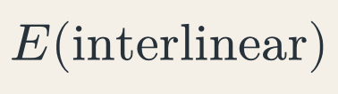
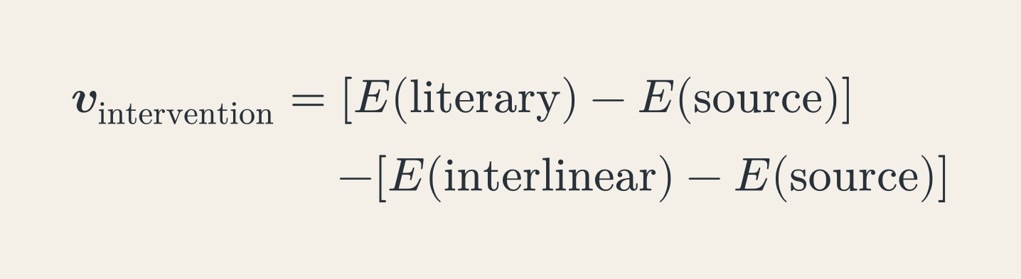


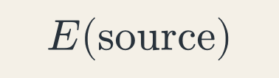

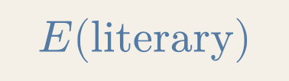
The Intervention Vector
Notes:
KEY POINTS
- difference between vectors
- shared source cancels
- two target-language representations
DETAILED NOTES
The Intervention Vector is the difference between the literary vector and the
interlinear vector.
[click]
We can expand both vectors as embedding differences relative to the shared
source.
[click]
The shared source term cancels algebraically.
[click]
This leaves E of the literary text minus E of the interlinear text. The final
subtraction uses two target-language representations.
[Sources]
- Rapacz, Maciej. EADH2026 accepted abstract, Intervention Vector definition.

Slide 41
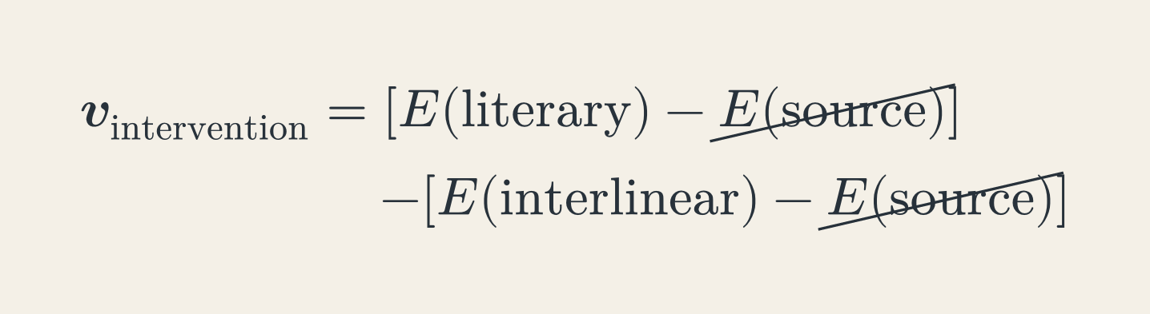
The Intervention Vector
Notes:
KEY POINTS
- difference between vectors
- shared source cancels
- two target-language representations
DETAILED NOTES
The Intervention Vector is the difference between the literary vector and the
interlinear vector.
[click]
We can expand both vectors as embedding differences relative to the shared
source.
[click]
The shared source term cancels algebraically.
[click]
This leaves E of the literary text minus E of the interlinear text. The final
subtraction uses two target-language representations.
[Sources]
- Rapacz, Maciej. EADH2026 accepted abstract, Intervention Vector definition.

Slide 42

The Intervention Vector
target language only
Notes:
KEY POINTS
- difference between vectors
- shared source cancels
- two target-language representations
DETAILED NOTES
The Intervention Vector is the difference between the literary vector and the
interlinear vector.
[click]
We can expand both vectors as embedding differences relative to the shared
source.
[click]
The shared source term cancels algebraically.
[click]
This leaves E of the literary text minus E of the interlinear text. The final
subtraction uses two target-language representations.
[Sources]
- Rapacz, Maciej. EADH2026 accepted abstract, Intervention Vector definition.

Slide 43
Two hypotheses
Notes:
KEY POINTS
- magnitude: extent?
- direction: character?
- hypotheses, not definitions
- Matthew 13:9: Disciples’ Literal New Testament 0.547; New World Translation
0.597; New Living Translation 0.656; The Message 0.903
- same verse/model/baseline; not quality
DETAILED NOTES
This vector gives us two hypotheses.
[click]
Its magnitude may encode the **extent** of intervention: how far the literary
translation moves from the constrained baseline.
[click]
Its direction may encode the **character** of intervention: not only how much
changed, but in what way.
These are hypotheses, not definitions. The remainder of the talk evaluates how
much support we currently have for them.
Before moving to the corpus-level experiment, consider one verse. In Matthew
13:9, four English translations form an interpretable progression in the
historical Qwen verse-level snapshot. The Disciples’ Literal New Testament is
at 0.547. [click] The New World Translation is at 0.597. [click] The New Living
Translation, which adds “understand,” is at 0.656. [click] The Message
recasts the verse as a direct conversational question and reaches 0.903.
This is the same verse, language, model, and historical baseline. The selected
case shows an ordering that makes intuitive sense; it does not turn magnitude
into a quality judgment or establish that every verse behaves this cleanly.
[Sources]
- Rapacz, Maciej. EADH2026 accepted abstract, magnitude and direction hypotheses.

Slide 44

Two hypotheses
≈
extent?
Notes:
KEY POINTS
- magnitude: extent?
- direction: character?
- hypotheses, not definitions
- Matthew 13:9: Disciples’ Literal New Testament 0.547; New World Translation
0.597; New Living Translation 0.656; The Message 0.903
- same verse/model/baseline; not quality
DETAILED NOTES
This vector gives us two hypotheses.
[click]
Its magnitude may encode the **extent** of intervention: how far the literary
translation moves from the constrained baseline.
[click]
Its direction may encode the **character** of intervention: not only how much
changed, but in what way.
These are hypotheses, not definitions. The remainder of the talk evaluates how
much support we currently have for them.
Before moving to the corpus-level experiment, consider one verse. In Matthew
13:9, four English translations form an interpretable progression in the
historical Qwen verse-level snapshot. The Disciples’ Literal New Testament is
at 0.547. [click] The New World Translation is at 0.597. [click] The New Living
Translation, which adds “understand,” is at 0.656. [click] The Message
recasts the verse as a direct conversational question and reaches 0.903.
This is the same verse, language, model, and historical baseline. The selected
case shows an ordering that makes intuitive sense; it does not turn magnitude
into a quality judgment or establish that every verse behaves this cleanly.
[Sources]
- Rapacz, Maciej. EADH2026 accepted abstract, magnitude and direction hypotheses.

Slide 45
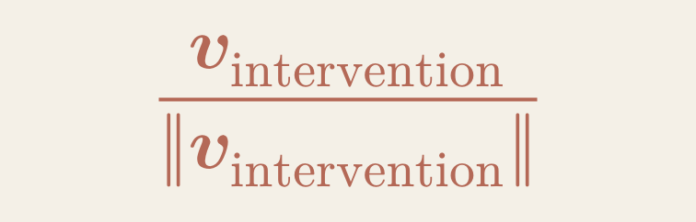
Two hypotheses
≈
extent?
≈
character?
Notes:
KEY POINTS
- magnitude: extent?
- direction: character?
- hypotheses, not definitions
- Matthew 13:9: Disciples’ Literal New Testament 0.547; New World Translation
0.597; New Living Translation 0.656; The Message 0.903
- same verse/model/baseline; not quality
DETAILED NOTES
This vector gives us two hypotheses.
[click]
Its magnitude may encode the **extent** of intervention: how far the literary
translation moves from the constrained baseline.
[click]
Its direction may encode the **character** of intervention: not only how much
changed, but in what way.
These are hypotheses, not definitions. The remainder of the talk evaluates how
much support we currently have for them.
Before moving to the corpus-level experiment, consider one verse. In Matthew
13:9, four English translations form an interpretable progression in the
historical Qwen verse-level snapshot. The Disciples’ Literal New Testament is
at 0.547. [click] The New World Translation is at 0.597. [click] The New Living
Translation, which adds “understand,” is at 0.656. [click] The Message
recasts the verse as a direct conversational question and reaches 0.903.
This is the same verse, language, model, and historical baseline. The selected
case shows an ordering that makes intuitive sense; it does not turn magnitude
into a quality judgment or establish that every verse behaves this cleanly.
[Sources]
- Rapacz, Maciej. EADH2026 accepted abstract, magnitude and direction hypotheses.

Slide 46
Magnitude in practice
Greek
Interlinear
ὁ ἔχων ὦτα ἀκουέτω
The [one] having ears let him hear
Disciples’ Literal New Testament
Let the one having ears, hear.
0.547
Matthew 13:9
Notes:
KEY POINTS
- magnitude: extent?
- direction: character?
- hypotheses, not definitions
- Matthew 13:9: Disciples’ Literal New Testament 0.547; New World Translation
0.597; New Living Translation 0.656; The Message 0.903
- same verse/model/baseline; not quality
DETAILED NOTES
Before testing magnitude across the full corpus, consider one verse with four English translations.
For Matthew 13:9, the historical Qwen verse-level snapshot gives a steadily increasing sequence: the Disciples’ Literal New Testament at 0.547, the New World Translation at 0.597, the New Living Translation at 0.656, and The Message at 0.903.
The wording moves from a close reordering of the interlinear baseline, through a more idiomatic instruction and an explicit addition of understanding, to a direct conversational reformulation.
These values use the same verse, language, model, and historical baseline. They illustrate an interpretable ordering in one selected case; they do not make magnitude a quality score.
[Sources]
- Historical Qwen3 verse-level embeddings used by the DH2026 analysis; values recorded in targum/public/sighum/data/monotonic_examples.txt.
- Matthew 13:9: Disciples’ Literal New Testament, New World Translation, New Living Translation, and The Message.
- Historical English interlinear baseline: BibleHub.

Slide 47
Magnitude in practice
Greek
Interlinear
ὁ ἔχων ὦτα ἀκουέτω
The [one] having ears let him hear
Disciples’ Literal New Testament
Let the one having ears, hear.
0.547
New World Translation
Let the one who has ears listen.
0.597
Matthew 13:9
Notes:
KEY POINTS
- magnitude: extent?
- direction: character?
- hypotheses, not definitions
- Matthew 13:9: Disciples’ Literal New Testament 0.547; New World Translation
0.597; New Living Translation 0.656; The Message 0.903
- same verse/model/baseline; not quality
DETAILED NOTES
Before testing magnitude across the full corpus, consider one verse with four English translations.
For Matthew 13:9, the historical Qwen verse-level snapshot gives a steadily increasing sequence: the Disciples’ Literal New Testament at 0.547, the New World Translation at 0.597, the New Living Translation at 0.656, and The Message at 0.903.
The wording moves from a close reordering of the interlinear baseline, through a more idiomatic instruction and an explicit addition of understanding, to a direct conversational reformulation.
These values use the same verse, language, model, and historical baseline. They illustrate an interpretable ordering in one selected case; they do not make magnitude a quality score.
[Sources]
- Historical Qwen3 verse-level embeddings used by the DH2026 analysis; values recorded in targum/public/sighum/data/monotonic_examples.txt.
- Matthew 13:9: Disciples’ Literal New Testament, New World Translation, New Living Translation, and The Message.
- Historical English interlinear baseline: BibleHub.

Slide 48
Magnitude in practice
Greek
Interlinear
ὁ ἔχων ὦτα ἀκουέτω
The [one] having ears let him hear
Disciples’ Literal New Testament
Let the one having ears, hear.
0.547
New World Translation
Let the one who has ears listen.
0.597
New Living Translation
Anyone with ears to hear should listen and understand.
0.656
Matthew 13:9
Notes:
KEY POINTS
- magnitude: extent?
- direction: character?
- hypotheses, not definitions
- Matthew 13:9: Disciples’ Literal New Testament 0.547; New World Translation
0.597; New Living Translation 0.656; The Message 0.903
- same verse/model/baseline; not quality
DETAILED NOTES
Before testing magnitude across the full corpus, consider one verse with four English translations.
For Matthew 13:9, the historical Qwen verse-level snapshot gives a steadily increasing sequence: the Disciples’ Literal New Testament at 0.547, the New World Translation at 0.597, the New Living Translation at 0.656, and The Message at 0.903.
The wording moves from a close reordering of the interlinear baseline, through a more idiomatic instruction and an explicit addition of understanding, to a direct conversational reformulation.
These values use the same verse, language, model, and historical baseline. They illustrate an interpretable ordering in one selected case; they do not make magnitude a quality score.
[Sources]
- Historical Qwen3 verse-level embeddings used by the DH2026 analysis; values recorded in targum/public/sighum/data/monotonic_examples.txt.
- Matthew 13:9: Disciples’ Literal New Testament, New World Translation, New Living Translation, and The Message.
- Historical English interlinear baseline: BibleHub.

Slide 49
Magnitude in practice
Greek
Interlinear
ὁ ἔχων ὦτα ἀκουέτω
The [one] having ears let him hear
Disciples’ Literal New Testament
Let the one having ears, hear.
0.547
New World Translation
Let the one who has ears listen.
0.597
New Living Translation
Anyone with ears to hear should listen and understand.
0.656
The Message
Are you listening to this? Really listening?
0.903
Matthew 13:9
Notes:
KEY POINTS
- magnitude: extent?
- direction: character?
- hypotheses, not definitions
- Matthew 13:9: Disciples’ Literal New Testament 0.547; New World Translation
0.597; New Living Translation 0.656; The Message 0.903
- same verse/model/baseline; not quality
DETAILED NOTES
Before testing magnitude across the full corpus, consider one verse with four English translations.
For Matthew 13:9, the historical Qwen verse-level snapshot gives a steadily increasing sequence: the Disciples’ Literal New Testament at 0.547, the New World Translation at 0.597, the New Living Translation at 0.656, and The Message at 0.903.
The wording moves from a close reordering of the interlinear baseline, through a more idiomatic instruction and an explicit addition of understanding, to a direct conversational reformulation.
These values use the same verse, language, model, and historical baseline. They illustrate an interpretable ordering in one selected case; they do not make magnitude a quality score.
[Sources]
- Historical Qwen3 verse-level embeddings used by the DH2026 analysis; values recorded in targum/public/sighum/data/monotonic_examples.txt.
- Matthew 13:9: Disciples’ Literal New Testament, New World Translation, New Living Translation, and The Message.
- Historical English interlinear baseline: BibleHub.

Slide 50
Evaluation
Notes:
KEY POINTS
- test the signal
DETAILED NOTES
Let me now move from the conceptual construction to the experiments.
[Sources]
- Rapacz, Maciej. EADH2026 accepted abstract.

Slide 51
Evaluation setup
Notes:
KEY POINTS
- Targum callback
- 74 records, five languages
- 260 chapters, five baselines
- name the five sites
- categories only for evaluation
- uneven category counts
DETAILED NOTES
[click]
I use translations from Targum, the corpus I presented yesterday. If you missed
that talk, the relevant point is simply that Targum brings together many
translations of the same New Testament books.
[click]
For this experiment, I selected 74 translation records in English, French,
Italian, Polish, and Spanish. Each language has an interlinear baseline, and
the unit of analysis is the chapter.
[click]
The five baselines came from BibleHub, Editeur BPC, Altervista, Oblubienica,
and BibliaTodo.
[click]
To evaluate magnitude, I placed the translations on a coarse four-point
orientational scale: Literal, Formal, Dynamic, and Paraphrase.
This scale is evaluation scaffolding. It is not an input to the embedding
model, a quality judgment, or a claim that translation naturally falls into
four boxes. I only use it to test whether broad differences appear in a
representation constructed without these labels.
The groups are not balanced across languages. English contains more Dynamic
translations, French and Polish more Formal translations, and Spanish more
Paraphrases. The table describes the available evaluation set; it is not a
sampling target.
[click]
I began with Qwen3-Embedding-8B.
[Sources]
- Rapacz et al. 2026. Targum corpus.
- Targum translations manifest and pinned experimental data snapshot.
- Selected interlinear sources: biblehub.com (English), editeurbpc.com (French), altervista.org (Italian), oblubienica.eu (Polish), and bibliatodo.com (Spanish).
- Targum mark © Targum project; used from the local presentation asset.

Slide 52

Evaluation setup
targum.net
Notes:
KEY POINTS
- Targum callback
- 74 records, five languages
- 260 chapters, five baselines
- name the five sites
- categories only for evaluation
- uneven category counts
DETAILED NOTES
[click]
I use translations from Targum, the corpus I presented yesterday. If you missed
that talk, the relevant point is simply that Targum brings together many
translations of the same New Testament books.
[click]
For this experiment, I selected 74 translation records in English, French,
Italian, Polish, and Spanish. Each language has an interlinear baseline, and
the unit of analysis is the chapter.
[click]
The five baselines came from BibleHub, Editeur BPC, Altervista, Oblubienica,
and BibliaTodo.
[click]
To evaluate magnitude, I placed the translations on a coarse four-point
orientational scale: Literal, Formal, Dynamic, and Paraphrase.
This scale is evaluation scaffolding. It is not an input to the embedding
model, a quality judgment, or a claim that translation naturally falls into
four boxes. I only use it to test whether broad differences appear in a
representation constructed without these labels.
The groups are not balanced across languages. English contains more Dynamic
translations, French and Polish more Formal translations, and Spanish more
Paraphrases. The table describes the available evaluation set; it is not a
sampling target.
[click]
I began with Qwen3-Embedding-8B.
[Sources]
- Rapacz et al. 2026. Targum corpus.
- Targum translations manifest and pinned experimental data snapshot.
- Selected interlinear sources: biblehub.com (English), editeurbpc.com (French), altervista.org (Italian), oblubienica.eu (Polish), and bibliatodo.com (Spanish).
- Targum mark © Targum project; used from the local presentation asset.

Slide 53
Evaluation setup
targum.net
74
5
260
5
translation records
languages
chapters
interlinear baselines
Notes:
KEY POINTS
- Targum callback
- 74 records, five languages
- 260 chapters, five baselines
- name the five sites
- categories only for evaluation
- uneven category counts
DETAILED NOTES
[click]
I use translations from Targum, the corpus I presented yesterday. If you missed
that talk, the relevant point is simply that Targum brings together many
translations of the same New Testament books.
[click]
For this experiment, I selected 74 translation records in English, French,
Italian, Polish, and Spanish. Each language has an interlinear baseline, and
the unit of analysis is the chapter.
[click]
The five baselines came from BibleHub, Editeur BPC, Altervista, Oblubienica,
and BibliaTodo.
[click]
To evaluate magnitude, I placed the translations on a coarse four-point
orientational scale: Literal, Formal, Dynamic, and Paraphrase.
This scale is evaluation scaffolding. It is not an input to the embedding
model, a quality judgment, or a claim that translation naturally falls into
four boxes. I only use it to test whether broad differences appear in a
representation constructed without these labels.
The groups are not balanced across languages. English contains more Dynamic
translations, French and Polish more Formal translations, and Spanish more
Paraphrases. The table describes the available evaluation set; it is not a
sampling target.
[click]
I began with Qwen3-Embedding-8B.
[Sources]
- Rapacz et al. 2026. Targum corpus.
- Targum translations manifest and pinned experimental data snapshot.
- Selected interlinear sources: biblehub.com (English), editeurbpc.com (French), altervista.org (Italian), oblubienica.eu (Polish), and bibliatodo.com (Spanish).
- Targum mark © Targum project; used from the local presentation asset.

Slide 54
Evaluation setup
targum.net
74
5
260
5
translation records
languages
chapters
interlinear baselines
EN biblehub.com · FR editeurbpc.com · IT altervista.org · PL oblubienica.eu · ES bibliatodo.com
Notes:
KEY POINTS
- Targum callback
- 74 records, five languages
- 260 chapters, five baselines
- name the five sites
- categories only for evaluation
- uneven category counts
DETAILED NOTES
[click]
I use translations from Targum, the corpus I presented yesterday. If you missed
that talk, the relevant point is simply that Targum brings together many
translations of the same New Testament books.
[click]
For this experiment, I selected 74 translation records in English, French,
Italian, Polish, and Spanish. Each language has an interlinear baseline, and
the unit of analysis is the chapter.
[click]
The five baselines came from BibleHub, Editeur BPC, Altervista, Oblubienica,
and BibliaTodo.
[click]
To evaluate magnitude, I placed the translations on a coarse four-point
orientational scale: Literal, Formal, Dynamic, and Paraphrase.
This scale is evaluation scaffolding. It is not an input to the embedding
model, a quality judgment, or a claim that translation naturally falls into
four boxes. I only use it to test whether broad differences appear in a
representation constructed without these labels.
The groups are not balanced across languages. English contains more Dynamic
translations, French and Polish more Formal translations, and Spanish more
Paraphrases. The table describes the available evaluation set; it is not a
sampling target.
[click]
I began with Qwen3-Embedding-8B.
[Sources]
- Rapacz et al. 2026. Targum corpus.
- Targum translations manifest and pinned experimental data snapshot.
- Selected interlinear sources: biblehub.com (English), editeurbpc.com (French), altervista.org (Italian), oblubienica.eu (Polish), and bibliatodo.com (Spanish).
- Targum mark © Targum project; used from the local presentation asset.

Slide 55
Evaluation setup
targum.net
Qwen3-Embedding-8B
74
5
260
5
translation records
languages
chapters
interlinear baselines
EN biblehub.com · FR editeurbpc.com · IT altervista.org · PL oblubienica.eu · ES bibliatodo.com
Literal
Formal
Dynamic
Paraphrase
English
3
4
7
2
French
1
6
4
3
Italian
4
4
2
2
Polish
4
7
2
3
Spanish
3
2
5
6
Notes:
KEY POINTS
- Targum callback
- 74 records, five languages
- 260 chapters, five baselines
- name the five sites
- categories only for evaluation
- uneven category counts
DETAILED NOTES
[click]
I use translations from Targum, the corpus I presented yesterday. If you missed
that talk, the relevant point is simply that Targum brings together many
translations of the same New Testament books.
[click]
For this experiment, I selected 74 translation records in English, French,
Italian, Polish, and Spanish. Each language has an interlinear baseline, and
the unit of analysis is the chapter.
[click]
The five baselines came from BibleHub, Editeur BPC, Altervista, Oblubienica,
and BibliaTodo.
[click]
To evaluate magnitude, I placed the translations on a coarse four-point
orientational scale: Literal, Formal, Dynamic, and Paraphrase.
This scale is evaluation scaffolding. It is not an input to the embedding
model, a quality judgment, or a claim that translation naturally falls into
four boxes. I only use it to test whether broad differences appear in a
representation constructed without these labels.
The groups are not balanced across languages. English contains more Dynamic
translations, French and Polish more Formal translations, and Spanish more
Paraphrases. The table describes the available evaluation set; it is not a
sampling target.
[click]
I began with Qwen3-Embedding-8B.
[Sources]
- Rapacz et al. 2026. Targum corpus.
- Targum translations manifest and pinned experimental data snapshot.
- Selected interlinear sources: biblehub.com (English), editeurbpc.com (French), altervista.org (Italian), oblubienica.eu (Polish), and bibliatodo.com (Spanish).
- Targum mark © Targum project; used from the local presentation asset.

Slide 56
Calculating intervention vectors
translation chapter
Qwen3
literary embedding
interlinear chapter
Qwen3
interlinear embedding
Notes:
KEY POINTS
- embed literary chapter
- embed interlinear chapter
- subtract
- roughly nineteen thousand vectors
DETAILED NOTES
For each translation and chapter, I encode the literary rendering and the
corresponding interlinear with the same model.
[click]
I subtract the interlinear embedding from the literary embedding. The result is
one intervention vector for that translation and chapter.
[click]
Across 74 translation records and 260 New Testament chapters, this gives us
roughly nineteen thousand vectors per model.
[Sources]
- Rapacz, Maciej. EADH2026 accepted abstract, intervention-vector computation.
- Pinned Targum experimental manifest: 74 translation records × 260 chapters.

Slide 57
Calculating intervention vectors
translation chapter
Qwen3
literary embedding
−
intervention
vector
interlinear chapter
Qwen3
interlinear embedding
Notes:
KEY POINTS
- embed literary chapter
- embed interlinear chapter
- subtract
- roughly nineteen thousand vectors
DETAILED NOTES
For each translation and chapter, I encode the literary rendering and the
corresponding interlinear with the same model.
[click]
I subtract the interlinear embedding from the literary embedding. The result is
one intervention vector for that translation and chapter.
[click]
Across 74 translation records and 260 New Testament chapters, this gives us
roughly nineteen thousand vectors per model.
[Sources]
- Rapacz, Maciej. EADH2026 accepted abstract, intervention-vector computation.
- Pinned Targum experimental manifest: 74 translation records × 260 chapters.

Slide 58
Calculating intervention vectors
translation chapter
Qwen3
literary embedding
−
intervention
vector
interlinear chapter
Qwen3
interlinear embedding
74 records × 260 chapters
→
~19k vectors
Notes:
KEY POINTS
- embed literary chapter
- embed interlinear chapter
- subtract
- roughly nineteen thousand vectors
DETAILED NOTES
For each translation and chapter, I encode the literary rendering and the
corresponding interlinear with the same model.
[click]
I subtract the interlinear embedding from the literary embedding. The result is
one intervention vector for that translation and chapter.
[click]
Across 74 translation records and 260 New Testament chapters, this gives us
roughly nineteen thousand vectors per model.
[Sources]
- Rapacz, Maciej. EADH2026 accepted abstract, intervention-vector computation.
- Pinned Targum experimental manifest: 74 translation records × 260 chapters.

Slide 59
Magnitude distributions
Notes:
KEY POINTS
- extremes work
- middle overlaps
- broad extent signal
DETAILED NOTES
Let us begin with magnitude.
[click through the languages]
Each panel shows chapter-level distance from the interlinear baseline,
separated by the four orientational groups.
The clearest result is the contrast at the extremes. Literal translations tend
to be closer to the interlinear, while paraphrases tend to be further away.
The middle is less clean. Formal and Dynamic translations overlap, and some
intermediate groups invert in Italian, Polish, and Spanish.
I would therefore not describe this as a perfect four-step scale. The safer
conclusion is that magnitude captures a broad extent signal, especially between
the extremes.
[Sources]
- Local Qwen chapter-level intervention dataset; figure generated from the pinned V1 snapshot.
- Cross-model sensitivity analysis in assets/figures/sensitivity-analysis.json.

Slide 60
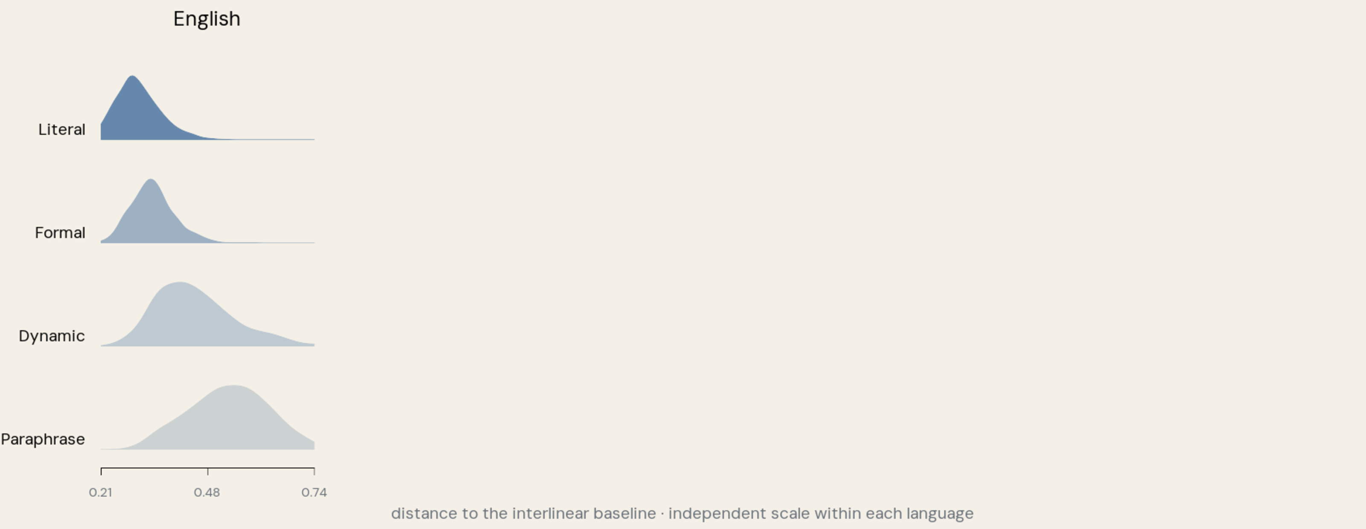
Magnitude distributions
Notes:
KEY POINTS
- extremes work
- middle overlaps
- broad extent signal
DETAILED NOTES
Let us begin with magnitude.
[click through the languages]
Each panel shows chapter-level distance from the interlinear baseline,
separated by the four orientational groups.
The clearest result is the contrast at the extremes. Literal translations tend
to be closer to the interlinear, while paraphrases tend to be further away.
The middle is less clean. Formal and Dynamic translations overlap, and some
intermediate groups invert in Italian, Polish, and Spanish.
I would therefore not describe this as a perfect four-step scale. The safer
conclusion is that magnitude captures a broad extent signal, especially between
the extremes.
[Sources]
- Local Qwen chapter-level intervention dataset; figure generated from the pinned V1 snapshot.
- Cross-model sensitivity analysis in assets/figures/sensitivity-analysis.json.

Slide 61
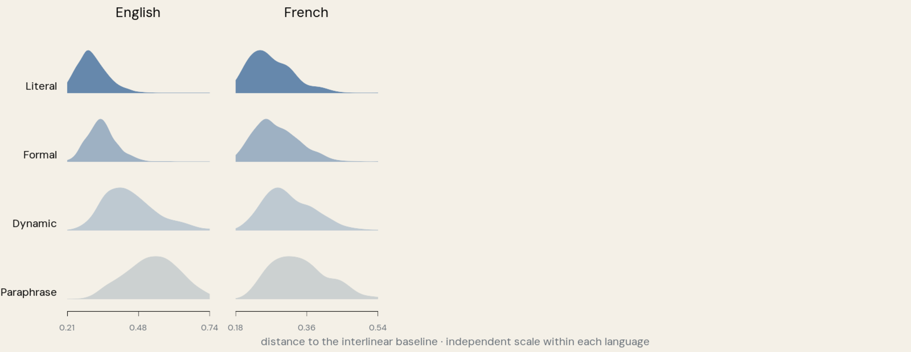
Magnitude distributions
Notes:
KEY POINTS
- extremes work
- middle overlaps
- broad extent signal
DETAILED NOTES
Let us begin with magnitude.
[click through the languages]
Each panel shows chapter-level distance from the interlinear baseline,
separated by the four orientational groups.
The clearest result is the contrast at the extremes. Literal translations tend
to be closer to the interlinear, while paraphrases tend to be further away.
The middle is less clean. Formal and Dynamic translations overlap, and some
intermediate groups invert in Italian, Polish, and Spanish.
I would therefore not describe this as a perfect four-step scale. The safer
conclusion is that magnitude captures a broad extent signal, especially between
the extremes.
[Sources]
- Local Qwen chapter-level intervention dataset; figure generated from the pinned V1 snapshot.
- Cross-model sensitivity analysis in assets/figures/sensitivity-analysis.json.

Slide 62
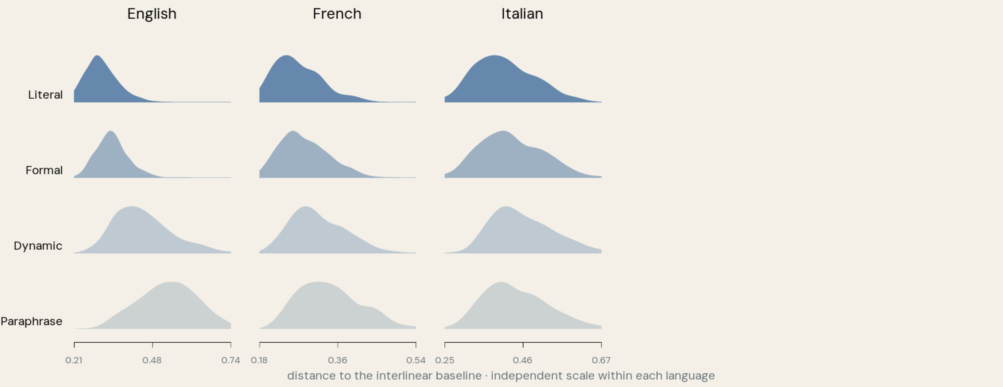
Magnitude distributions
Notes:
KEY POINTS
- extremes work
- middle overlaps
- broad extent signal
DETAILED NOTES
Let us begin with magnitude.
[click through the languages]
Each panel shows chapter-level distance from the interlinear baseline,
separated by the four orientational groups.
The clearest result is the contrast at the extremes. Literal translations tend
to be closer to the interlinear, while paraphrases tend to be further away.
The middle is less clean. Formal and Dynamic translations overlap, and some
intermediate groups invert in Italian, Polish, and Spanish.
I would therefore not describe this as a perfect four-step scale. The safer
conclusion is that magnitude captures a broad extent signal, especially between
the extremes.
[Sources]
- Local Qwen chapter-level intervention dataset; figure generated from the pinned V1 snapshot.
- Cross-model sensitivity analysis in assets/figures/sensitivity-analysis.json.

Slide 63
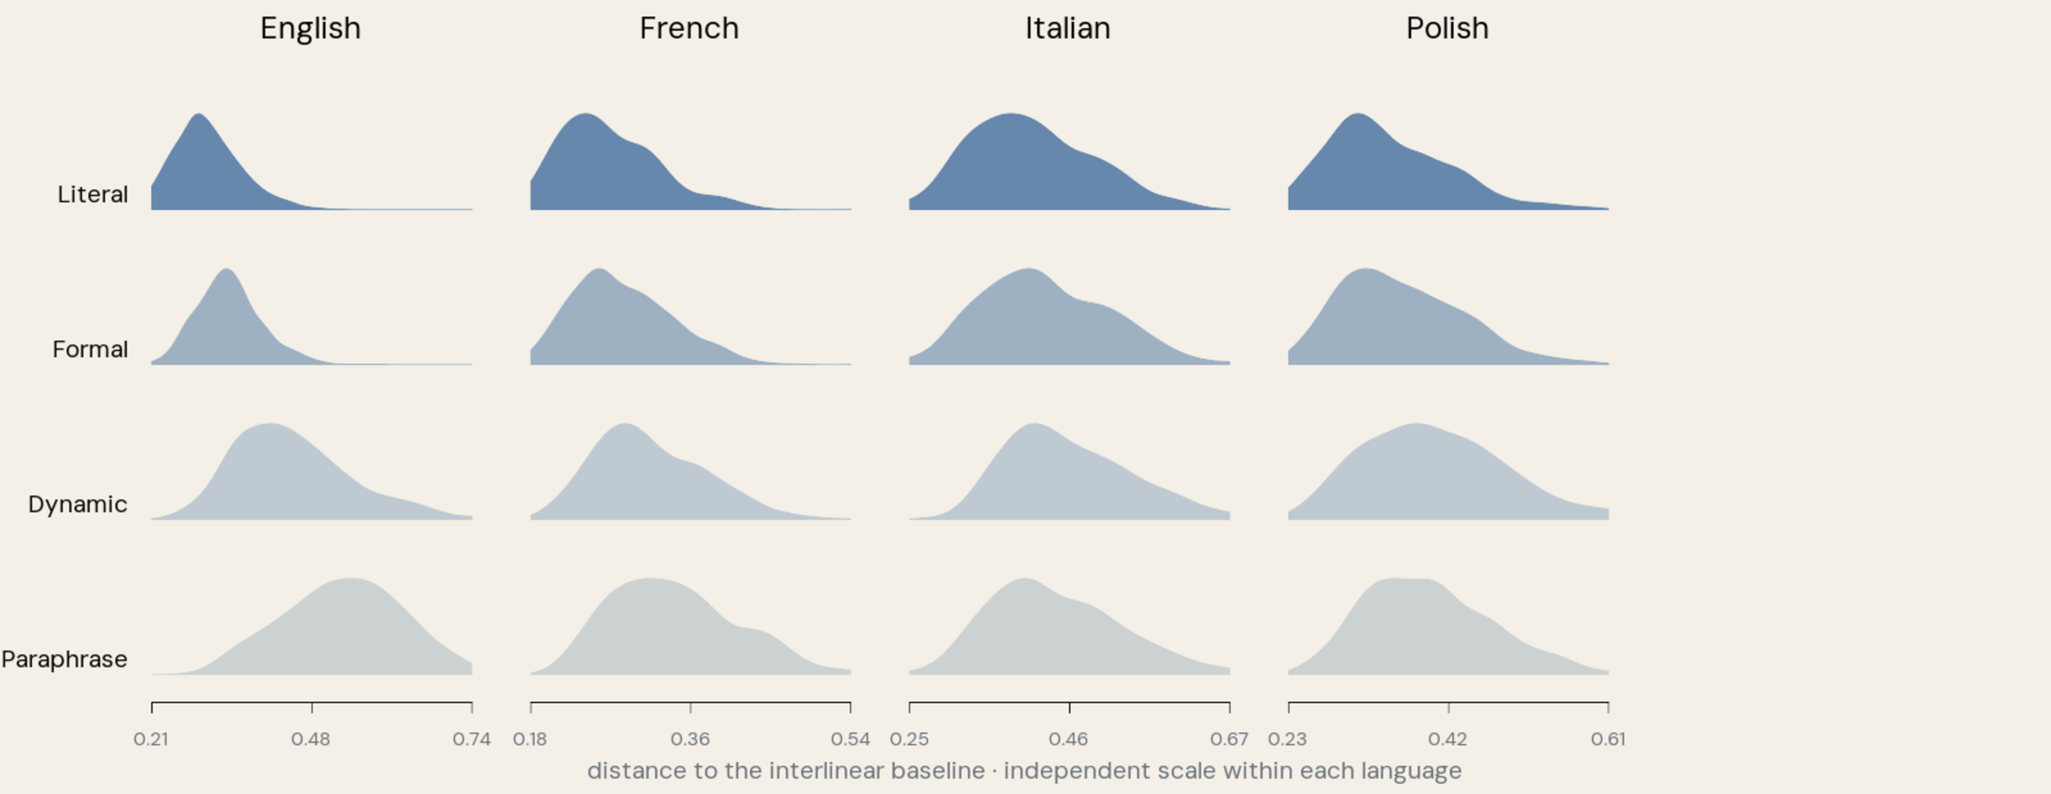
Magnitude distributions
Notes:
KEY POINTS
- extremes work
- middle overlaps
- broad extent signal
DETAILED NOTES
Let us begin with magnitude.
[click through the languages]
Each panel shows chapter-level distance from the interlinear baseline,
separated by the four orientational groups.
The clearest result is the contrast at the extremes. Literal translations tend
to be closer to the interlinear, while paraphrases tend to be further away.
The middle is less clean. Formal and Dynamic translations overlap, and some
intermediate groups invert in Italian, Polish, and Spanish.
I would therefore not describe this as a perfect four-step scale. The safer
conclusion is that magnitude captures a broad extent signal, especially between
the extremes.
[Sources]
- Local Qwen chapter-level intervention dataset; figure generated from the pinned V1 snapshot.
- Cross-model sensitivity analysis in assets/figures/sensitivity-analysis.json.

Slide 64
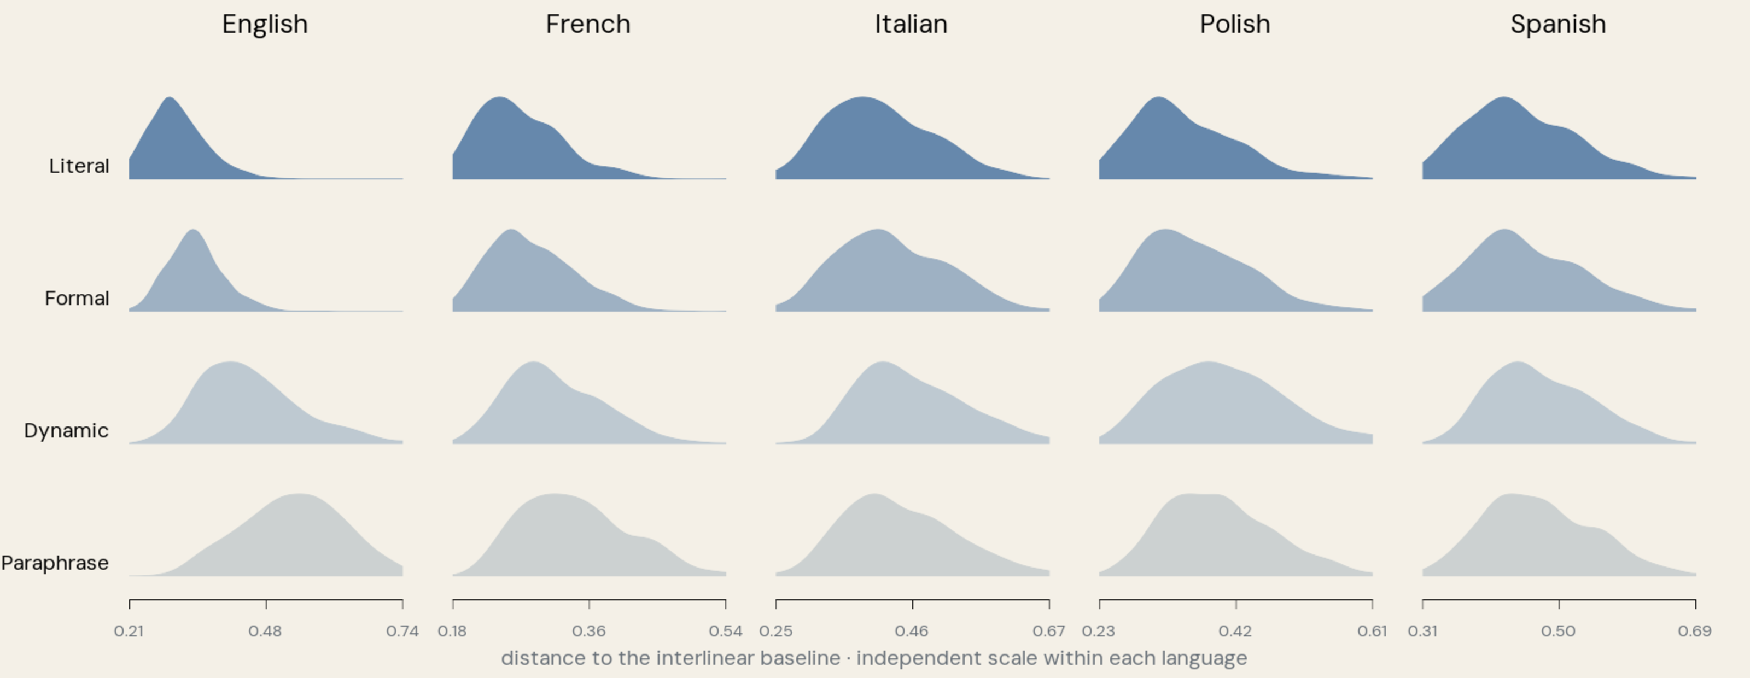
Magnitude distributions
Notes:
KEY POINTS
- extremes work
- middle overlaps
- broad extent signal
DETAILED NOTES
Let us begin with magnitude.
[click through the languages]
Each panel shows chapter-level distance from the interlinear baseline,
separated by the four orientational groups.
The clearest result is the contrast at the extremes. Literal translations tend
to be closer to the interlinear, while paraphrases tend to be further away.
The middle is less clean. Formal and Dynamic translations overlap, and some
intermediate groups invert in Italian, Polish, and Spanish.
I would therefore not describe this as a perfect four-step scale. The safer
conclusion is that magnitude captures a broad extent signal, especially between
the extremes.
[Sources]
- Local Qwen chapter-level intervention dataset; figure generated from the pinned V1 snapshot.
- Cross-model sensitivity analysis in assets/figures/sensitivity-analysis.json.

Slide 65
Group comparisons
Notes:
KEY POINTS
- English clearest
- broad contrast persists
- chapters are dependent
DETAILED NOTES
We can test these group differences directly.
[click]
A coloured cell means that chapters in the row group tend to have shorter
vectors than chapters in the column group, using a one-sided Mann–Whitney test
with Bonferroni correction.
[click]
English and French show particularly clear group ordering. The other languages
retain much of the broad contrast, but the intermediate boundaries are less
stable.
This supports the main qualification: the extremes are more reliable than the
complete four-category ordering.
These are chapter-level tests, and chapters within one translation are not
independent. I therefore treat the significance as descriptive evidence within
this dataset.
[Sources]
- Local Qwen groupwise Mann–Whitney results; Bonferroni-adjusted one-sided tests.

Slide 66
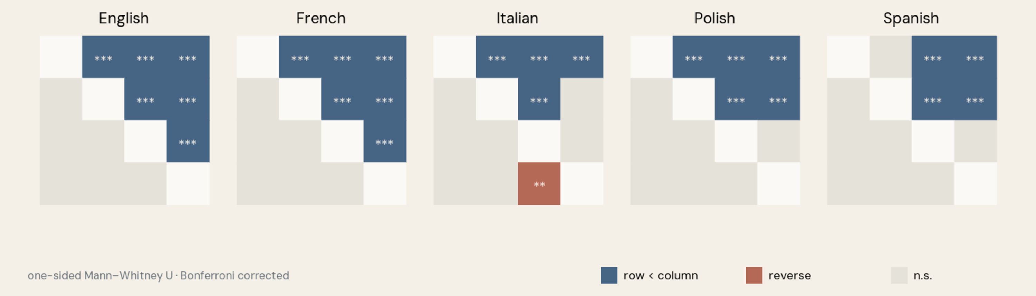
Group comparisons
Notes:
KEY POINTS
- English clearest
- broad contrast persists
- chapters are dependent
DETAILED NOTES
We can test these group differences directly.
[click]
A coloured cell means that chapters in the row group tend to have shorter
vectors than chapters in the column group, using a one-sided Mann–Whitney test
with Bonferroni correction.
[click]
English and French show particularly clear group ordering. The other languages
retain much of the broad contrast, but the intermediate boundaries are less
stable.
This supports the main qualification: the extremes are more reliable than the
complete four-category ordering.
These are chapter-level tests, and chapters within one translation are not
independent. I therefore treat the significance as descriptive evidence within
this dataset.
[Sources]
- Local Qwen groupwise Mann–Whitney results; Bonferroni-adjusted one-sided tests.

Slide 67
Group comparisons
Notes:
KEY POINTS
- English clearest
- broad contrast persists
- chapters are dependent
DETAILED NOTES
We can test these group differences directly.
[click]
A coloured cell means that chapters in the row group tend to have shorter
vectors than chapters in the column group, using a one-sided Mann–Whitney test
with Bonferroni correction.
[click]
English and French show particularly clear group ordering. The other languages
retain much of the broad contrast, but the intermediate boundaries are less
stable.
This supports the main qualification: the extremes are more reliable than the
complete four-category ordering.
These are chapter-level tests, and chapters within one translation are not
independent. I therefore treat the significance as descriptive evidence within
this dataset.
[Sources]
- Local Qwen groupwise Mann–Whitney results; Bonferroni-adjusted one-sided tests.

Slide 68
Translation comparisons
Notes:
KEY POINTS
- translation-specific structure
- English around ninety percent
- blank does not mean equal
DETAILED NOTES
We can also compare individual translations rather than aggregated groups.
[click through the languages]
In English, around ninety percent of eligible translation pairs show a
supported ordering. A chapter from one translation tends to have a shorter
vector than a chapter from the other.
The proportion is lower in the remaining languages, but the matrices still
contain substantial translation-specific structure.
A blank cell does not mean that two translations are equivalent. It only means
that this test did not establish the specified ordering.
[Sources]
- Local Qwen translation-level Mann–Whitney results; Bonferroni-adjusted one-sided tests.

Slide 69
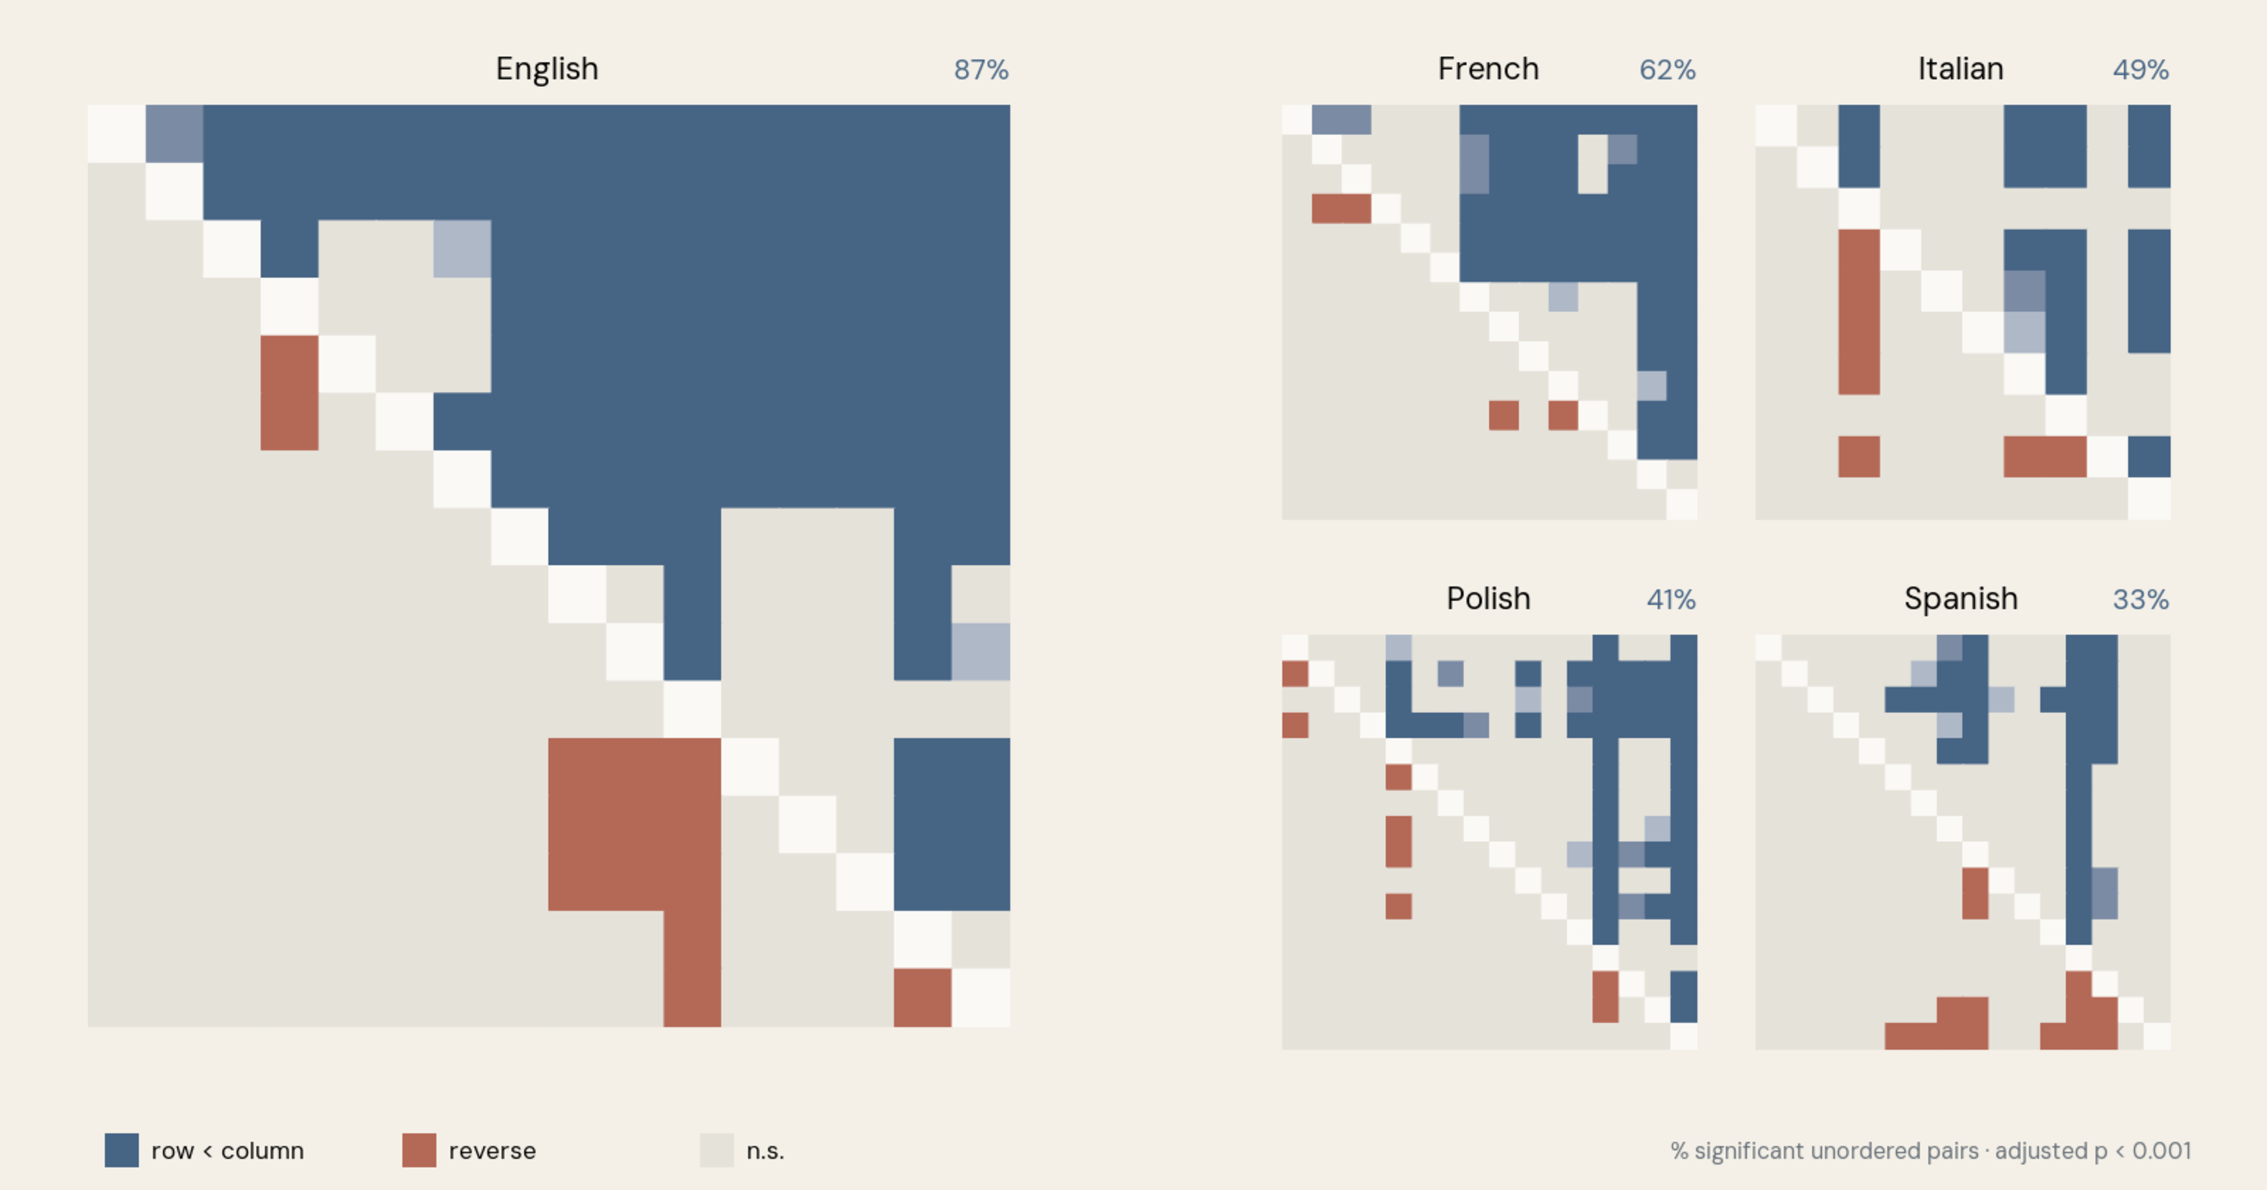
Translation comparisons
Notes:
KEY POINTS
- translation-specific structure
- English around ninety percent
- blank does not mean equal
DETAILED NOTES
We can also compare individual translations rather than aggregated groups.
[click through the languages]
In English, around ninety percent of eligible translation pairs show a
supported ordering. A chapter from one translation tends to have a shorter
vector than a chapter from the other.
The proportion is lower in the remaining languages, but the matrices still
contain substantial translation-specific structure.
A blank cell does not mean that two translations are equivalent. It only means
that this test did not establish the specified ordering.
[Sources]
- Local Qwen translation-level Mann–Whitney results; Bonferroni-adjusted one-sided tests.

Slide 70
Translation comparisons
Notes:
KEY POINTS
- translation-specific structure
- English around ninety percent
- blank does not mean equal
DETAILED NOTES
We can also compare individual translations rather than aggregated groups.
[click through the languages]
In English, around ninety percent of eligible translation pairs show a
supported ordering. A chapter from one translation tends to have a shorter
vector than a chapter from the other.
The proportion is lower in the remaining languages, but the matrices still
contain substantial translation-specific structure.
A blank cell does not mean that two translations are equivalent. It only means
that this test did not establish the specified ordering.
[Sources]
- Local Qwen translation-level Mann–Whitney results; Bonferroni-adjusted one-sided tests.

Slide 71
Three embedding models
Notes:
KEY POINTS
- different model spaces
- Qwen and Nemotron: 32k, 4096
- LaBSE: about 512, 768
DETAILED NOTES
The next question is whether this pattern is merely an artifact of Qwen.
[click]
Qwen uses a context window of 32,768 tokens and produces 4,096-dimensional
embeddings.
[click]
Nemotron has the same context and embedding dimensions. LaBSE produces
768-dimensional embeddings and supports up to approximately 512 tokens in our
configuration. Because that context is shorter, I embed verses and average
them into chapter representations.
These are different representation families and, for LaBSE, a different
aggregation procedure.
[Sources]
- Zhang et al. 2025. “Qwen3 Embedding.” arXiv:2506.05176.
- NVIDIA. llama-embed-nemotron-8b model documentation.
- Feng et al. 2022. “Language-agnostic BERT Sentence Embedding.” ACL 2022.
- sentence-transformers/LaBSE model card and checkpoint configuration.

Slide 72
Three embedding models
Model
Context window
Embedding size
Qwen3-Embedding-8B
32,768
4,096
Notes:
KEY POINTS
- different model spaces
- Qwen and Nemotron: 32k, 4096
- LaBSE: about 512, 768
DETAILED NOTES
The next question is whether this pattern is merely an artifact of Qwen.
[click]
Qwen uses a context window of 32,768 tokens and produces 4,096-dimensional
embeddings.
[click]
Nemotron has the same context and embedding dimensions. LaBSE produces
768-dimensional embeddings and supports up to approximately 512 tokens in our
configuration. Because that context is shorter, I embed verses and average
them into chapter representations.
These are different representation families and, for LaBSE, a different
aggregation procedure.
[Sources]
- Zhang et al. 2025. “Qwen3 Embedding.” arXiv:2506.05176.
- NVIDIA. llama-embed-nemotron-8b model documentation.
- Feng et al. 2022. “Language-agnostic BERT Sentence Embedding.” ACL 2022.
- sentence-transformers/LaBSE model card and checkpoint configuration.

Slide 73
Three embedding models
Model
Context window
Embedding size
Qwen3-Embedding-8B
32,768
4,096
llama-embed-nemotron-8b
32,768
4,096
LaBSE
up to 512
768
Notes:
KEY POINTS
- different model spaces
- Qwen and Nemotron: 32k, 4096
- LaBSE: about 512, 768
DETAILED NOTES
The next question is whether this pattern is merely an artifact of Qwen.
[click]
Qwen uses a context window of 32,768 tokens and produces 4,096-dimensional
embeddings.
[click]
Nemotron has the same context and embedding dimensions. LaBSE produces
768-dimensional embeddings and supports up to approximately 512 tokens in our
configuration. Because that context is shorter, I embed verses and average
them into chapter representations.
These are different representation families and, for LaBSE, a different
aggregation procedure.
[Sources]
- Zhang et al. 2025. “Qwen3 Embedding.” arXiv:2506.05176.
- NVIDIA. llama-embed-nemotron-8b model documentation.
- Feng et al. 2022. “Language-agnostic BERT Sentence Embedding.” ACL 2022.
- sentence-transformers/LaBSE model card and checkpoint configuration.

Slide 74
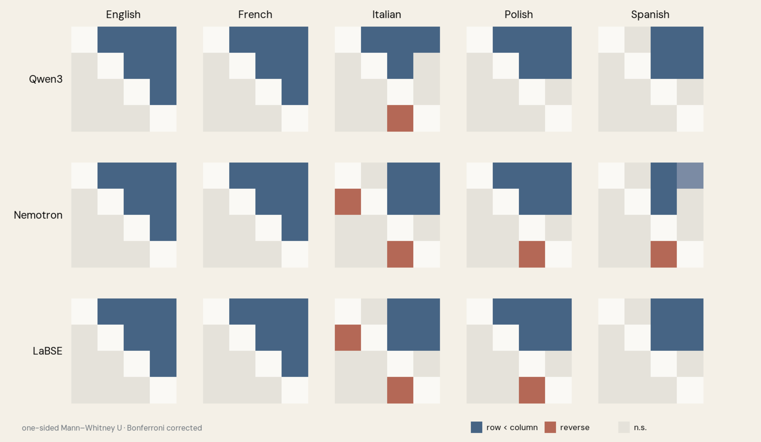
Group comparisons across models
Notes:
KEY POINTS
- extremes: fifteen of fifteen
- middle order unstable
- not model-universal
DETAILED NOTES
[click through the model rows]
The broad extreme contrast survives all three models. Literal translations are
closer than paraphrases in all fifteen model-by-language combinations.
The complete Literal–Formal–Dynamic–Paraphrase ordering is less stable. It
holds in only forty to sixty percent of languages, depending on the model, with
most inversions around the intermediate categories.
The extent signal is therefore not unique to Qwen. Three models, however, are
not enough to claim model independence.
[Sources]
- Local Qwen, Nemotron, and LaBSE chapter-level results; pinned V1 snapshot.

Slide 75
Group comparisons across models
Notes:
KEY POINTS
- extremes: fifteen of fifteen
- middle order unstable
- not model-universal
DETAILED NOTES
[click through the model rows]
The broad extreme contrast survives all three models. Literal translations are
closer than paraphrases in all fifteen model-by-language combinations.
The complete Literal–Formal–Dynamic–Paraphrase ordering is less stable. It
holds in only forty to sixty percent of languages, depending on the model, with
most inversions around the intermediate categories.
The extent signal is therefore not unique to Qwen. Three models, however, are
not enough to claim model independence.
[Sources]
- Local Qwen, Nemotron, and LaBSE chapter-level results; pinned V1 snapshot.

Slide 76
Group comparisons across models
Notes:
KEY POINTS
- extremes: fifteen of fifteen
- middle order unstable
- not model-universal
DETAILED NOTES
[click through the model rows]
The broad extreme contrast survives all three models. Literal translations are
closer than paraphrases in all fifteen model-by-language combinations.
The complete Literal–Formal–Dynamic–Paraphrase ordering is less stable. It
holds in only forty to sixty percent of languages, depending on the model, with
most inversions around the intermediate categories.
The extent signal is therefore not unique to Qwen. Three models, however, are
not enough to claim model independence.
[Sources]
- Local Qwen, Nemotron, and LaBSE chapter-level results; pinned V1 snapshot.

Slide 77
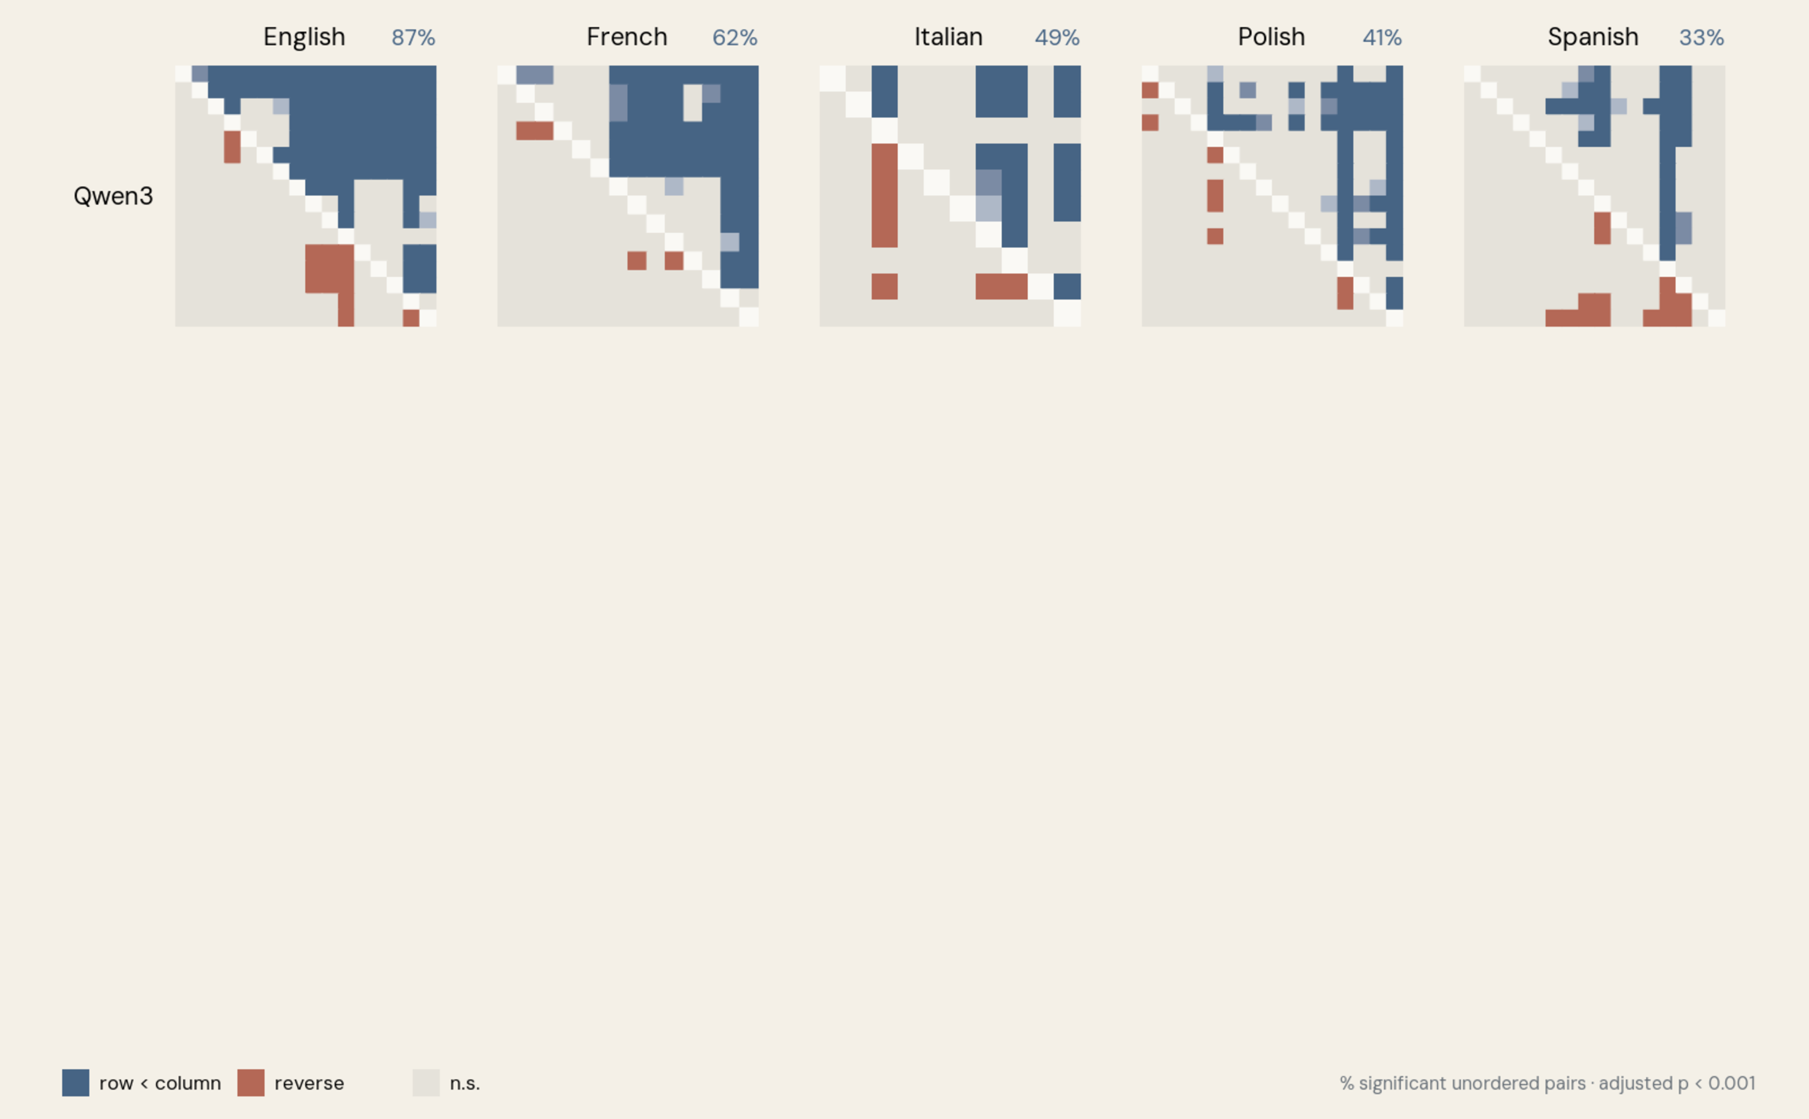
Translation comparisons across models
Notes:
KEY POINTS
- recurring orderings
- some model dependence
- compare patterns, not distances
DETAILED NOTES
The translation-level comparisons show a similar pattern.
[click through the model rows]
The percentages above the matrices show how many eligible translation pairs
receive a supported ordering. Many orderings recur across model spaces, while
others change.
Raw distances are not comparable between models. For example, a value of 0.4
in Qwen is not equivalent to 0.4 in LaBSE. What we can compare is the
within-model ordering and the overall pattern.
[Sources]
- Local Qwen, Nemotron, and LaBSE translation-level comparisons; pinned V1 snapshot.

Slide 78
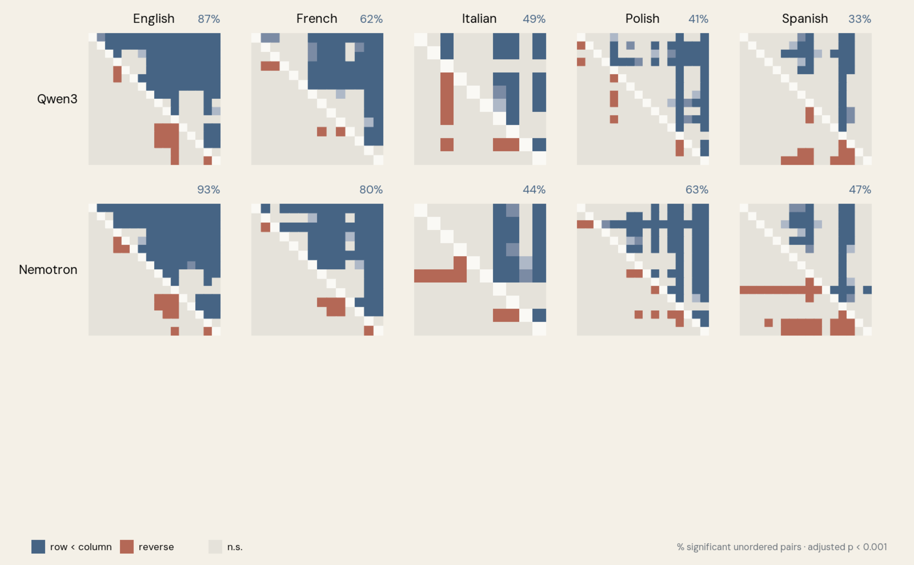
Translation comparisons across models
Notes:
KEY POINTS
- recurring orderings
- some model dependence
- compare patterns, not distances
DETAILED NOTES
The translation-level comparisons show a similar pattern.
[click through the model rows]
The percentages above the matrices show how many eligible translation pairs
receive a supported ordering. Many orderings recur across model spaces, while
others change.
Raw distances are not comparable between models. For example, a value of 0.4
in Qwen is not equivalent to 0.4 in LaBSE. What we can compare is the
within-model ordering and the overall pattern.
[Sources]
- Local Qwen, Nemotron, and LaBSE translation-level comparisons; pinned V1 snapshot.

Slide 79
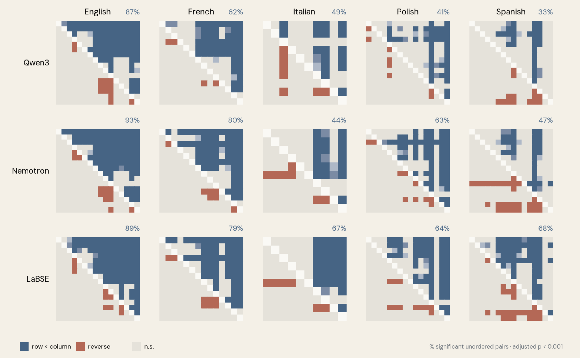
Translation comparisons across models
Notes:
KEY POINTS
- recurring orderings
- some model dependence
- compare patterns, not distances
DETAILED NOTES
The translation-level comparisons show a similar pattern.
[click through the model rows]
The percentages above the matrices show how many eligible translation pairs
receive a supported ordering. Many orderings recur across model spaces, while
others change.
Raw distances are not comparable between models. For example, a value of 0.4
in Qwen is not equivalent to 0.4 in LaBSE. What we can compare is the
within-model ordering and the overall pattern.
[Sources]
- Local Qwen, Nemotron, and LaBSE translation-level comparisons; pinned V1 snapshot.

Slide 80
magnitude
→
direction
Notes:
KEY POINTS
- extent to character
DETAILED NOTES
So magnitude appears promising, especially for broad contrasts. Let us now
return to the second hypothesis: direction.
[Sources]
- Rapacz, Maciej. EADH2026 accepted abstract.

Slide 81
Intervention topology
Notes:
KEY POINTS
- PCA by language
- exploratory and lossy
- language-specific projections
DETAILED NOTES
[click]
I projected the chapter-level intervention vectors into two dimensions using
PCA, fitted separately for each language.
PCA is deliberately lossy. These plots compress thousands of dimensions into
two, so they are an exploratory view rather than the full representation.
Even so, some translations form visible structures. The clearest example is
English.
[Sources]
- Corrected Qwen PCA projections released with the EACL/SIGHUM analysis, fitted independently within each language.

Slide 82
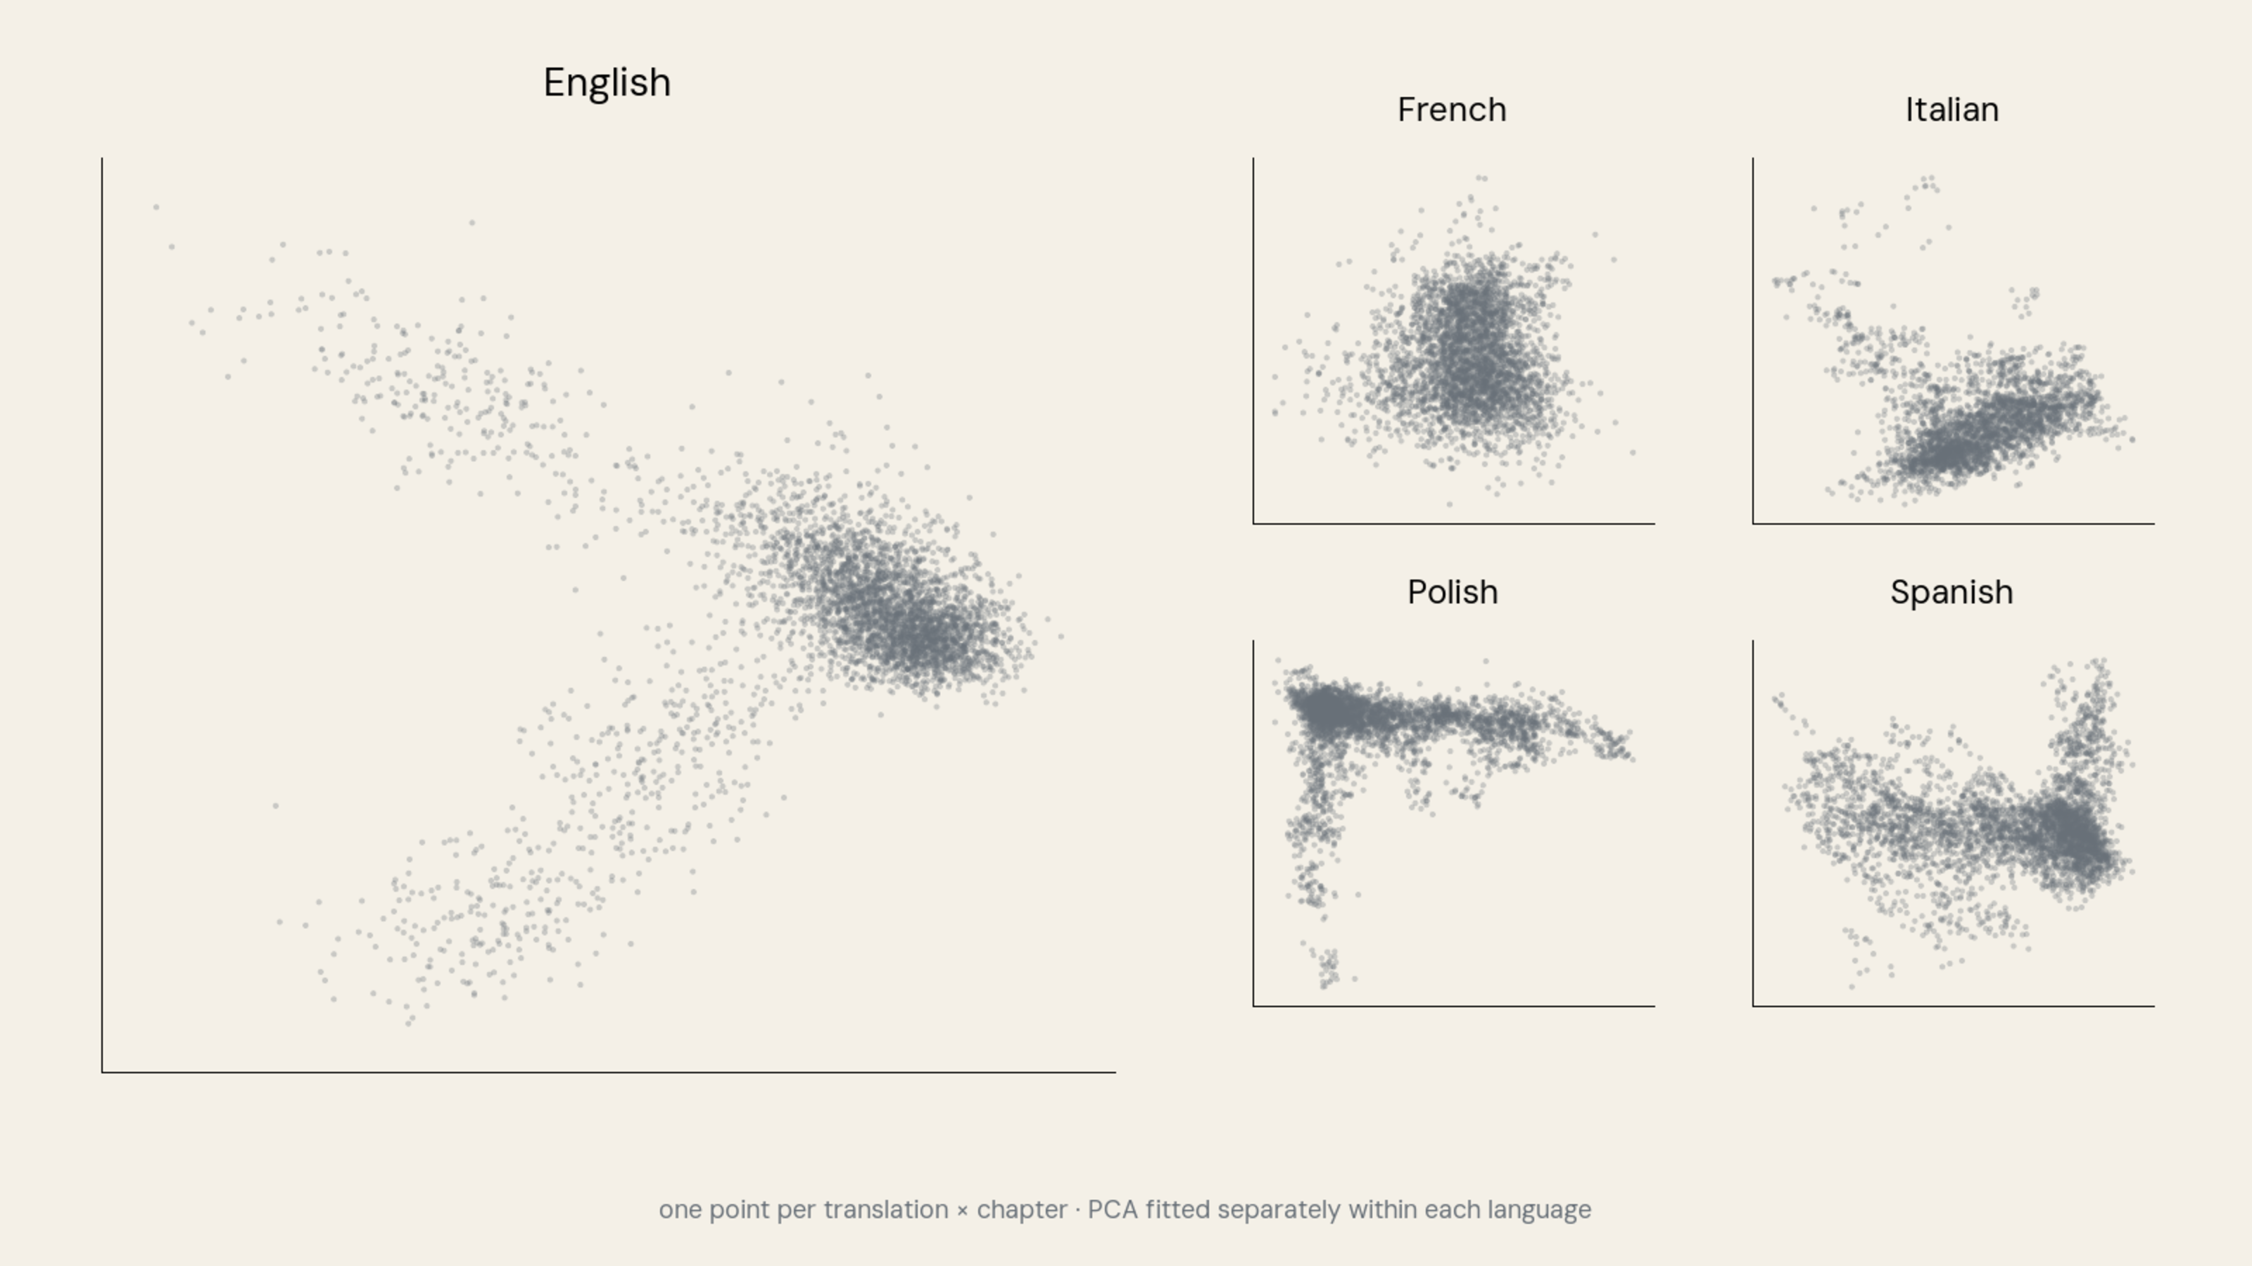
Intervention topology
Notes:
KEY POINTS
- PCA by language
- exploratory and lossy
- language-specific projections
DETAILED NOTES
[click]
I projected the chapter-level intervention vectors into two dimensions using
PCA, fitted separately for each language.
PCA is deliberately lossy. These plots compress thousands of dimensions into
two, so they are an exploratory view rather than the full representation.
Even so, some translations form visible structures. The clearest example is
English.
[Sources]
- Corrected Qwen PCA projections released with the EACL/SIGHUM analysis, fitted independently within each language.

Slide 83
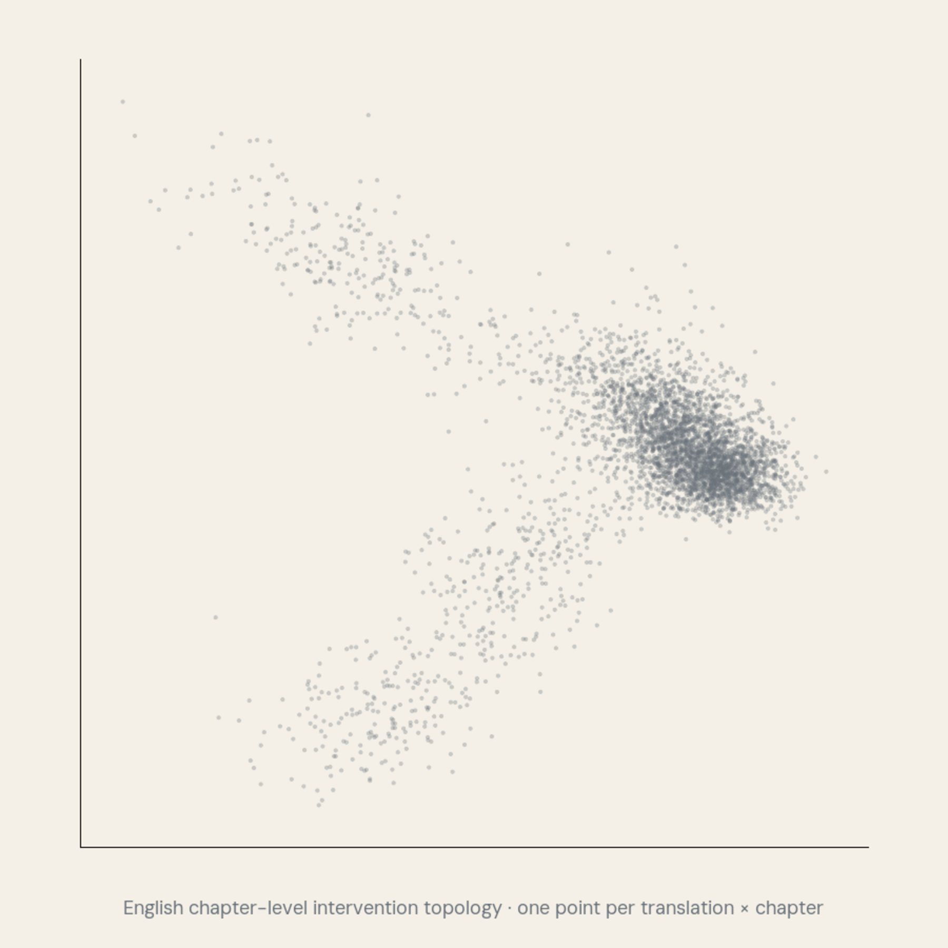
English topology
Notes:
KEY POINTS
- chapter-level swarm
- FNV and OJB arms
- clusters outside labels
DETAILED NOTES
[click]
This arm belongs to the First Nations Version, or FNV.
[click]
The other belongs to the Orthodox Jewish Bible, or OJB.
Both translations have many high-magnitude vectors, but they occupy different
regions of the projection. The easiest way to understand the distinction is to
look at one passage.
[Sources]
- Corrected released Qwen English PCA projections; FNV and OJB identifiers from the Targum manifest.

Slide 84
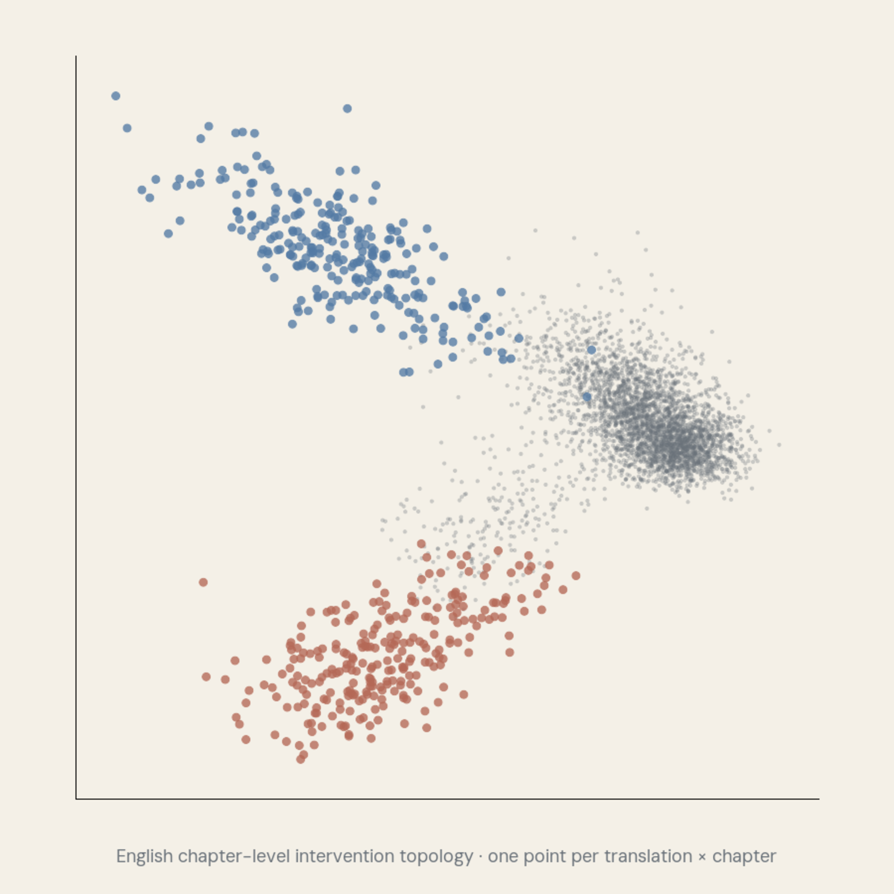
English topology
Notes:
KEY POINTS
- chapter-level swarm
- FNV and OJB arms
- clusters outside labels
DETAILED NOTES
[click]
This arm belongs to the First Nations Version, or FNV.
[click]
The other belongs to the Orthodox Jewish Bible, or OJB.
Both translations have many high-magnitude vectors, but they occupy different
regions of the projection. The easiest way to understand the distinction is to
look at one passage.
[Sources]
- Corrected released Qwen English PCA projections; FNV and OJB identifiers from the Targum manifest.

Slide 85
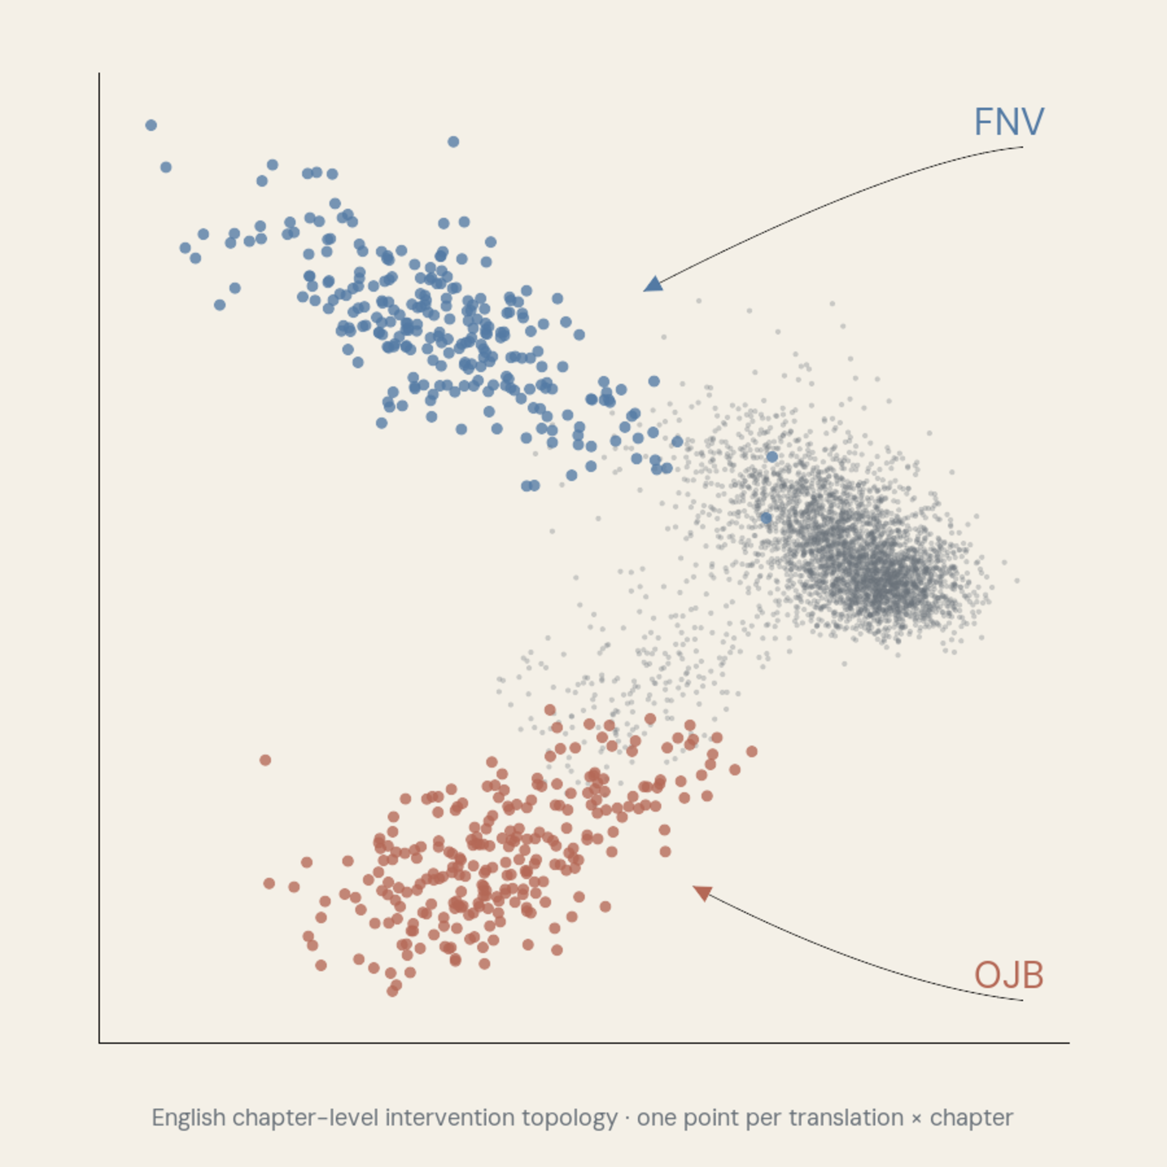
English topology
Notes:
KEY POINTS
- chapter-level swarm
- FNV and OJB arms
- clusters outside labels
DETAILED NOTES
[click]
This arm belongs to the First Nations Version, or FNV.
[click]
The other belongs to the Orthodox Jewish Bible, or OJB.
Both translations have many high-magnitude vectors, but they occupy different
regions of the projection. The easiest way to understand the distinction is to
look at one passage.
[Sources]
- Corrected released Qwen English PCA projections; FNV and OJB identifiers from the Targum manifest.

Slide 86

Acts 17:33
Greek
Οὕτως ὁ Παῦλος ἐξῆλθεν ἐκ μέσου αὐτῶν.
Notes:
KEY POINTS
- Greek, interlinear, FNV, OJB
- FNV adds cultural framing
- OJB preserves Jewish terminology
- direction may encode character
DETAILED NOTES
Here is the Greek source.
[click]
The interlinear rendering reads: “Thus Paul went out from the midst of them.”
[click]
The First Nations Version gives us: “So Small Man went on his way.” It renders
Paul as *Small Man*.
[click]
The Orthodox Jewish Bible gives us: “Thus did Rav Sha’ul go out from the midst
of them.” It uses the Hebraic form *Rav Sha’ul*.
Both translations depart strongly from the interlinear baseline, but in
different directions.
This selected example does not prove that every direction has a stable
linguistic interpretation. It shows that the representation preserves
interpretable translation-specific structure in at least one case.
[Sources]
- Acts 17:33 in the Greek New Testament, interlinear baseline, First Nations Version, and Orthodox Jewish Bible.
- Corrected released Qwen English PCA projections.

Slide 87
Acts 17:33
Greek
Οὕτως ὁ Παῦλος ἐξῆλθεν ἐκ μέσου αὐτῶν.
Interlinear
Thus Paul went out from the midst of them.
Notes:
KEY POINTS
- Greek, interlinear, FNV, OJB
- FNV adds cultural framing
- OJB preserves Jewish terminology
- direction may encode character
DETAILED NOTES
Here is the Greek source.
[click]
The interlinear rendering reads: “Thus Paul went out from the midst of them.”
[click]
The First Nations Version gives us: “So Small Man went on his way.” It renders
Paul as *Small Man*.
[click]
The Orthodox Jewish Bible gives us: “Thus did Rav Sha’ul go out from the midst
of them.” It uses the Hebraic form *Rav Sha’ul*.
Both translations depart strongly from the interlinear baseline, but in
different directions.
This selected example does not prove that every direction has a stable
linguistic interpretation. It shows that the representation preserves
interpretable translation-specific structure in at least one case.
[Sources]
- Acts 17:33 in the Greek New Testament, interlinear baseline, First Nations Version, and Orthodox Jewish Bible.
- Corrected released Qwen English PCA projections.

Slide 88
Acts 17:33
Greek
Οὕτως ὁ Παῦλος ἐξῆλθεν ἐκ μέσου αὐτῶν.
Interlinear
Thus Paul went out from the midst of them.
FNV
So Small Man went on his way.
Notes:
KEY POINTS
- Greek, interlinear, FNV, OJB
- FNV adds cultural framing
- OJB preserves Jewish terminology
- direction may encode character
DETAILED NOTES
Here is the Greek source.
[click]
The interlinear rendering reads: “Thus Paul went out from the midst of them.”
[click]
The First Nations Version gives us: “So Small Man went on his way.” It renders
Paul as *Small Man*.
[click]
The Orthodox Jewish Bible gives us: “Thus did Rav Sha’ul go out from the midst
of them.” It uses the Hebraic form *Rav Sha’ul*.
Both translations depart strongly from the interlinear baseline, but in
different directions.
This selected example does not prove that every direction has a stable
linguistic interpretation. It shows that the representation preserves
interpretable translation-specific structure in at least one case.
[Sources]
- Acts 17:33 in the Greek New Testament, interlinear baseline, First Nations Version, and Orthodox Jewish Bible.
- Corrected released Qwen English PCA projections.

Slide 89
Acts 17:33
Greek
Οὕτως ὁ Παῦλος ἐξῆλθεν ἐκ μέσου αὐτῶν.
Interlinear
Thus Paul went out from the midst of them.
FNV
So Small Man went on his way.
OJB
Thus did Rav Sha’ul go out from the midst of them.
Notes:
KEY POINTS
- Greek, interlinear, FNV, OJB
- FNV adds cultural framing
- OJB preserves Jewish terminology
- direction may encode character
DETAILED NOTES
Here is the Greek source.
[click]
The interlinear rendering reads: “Thus Paul went out from the midst of them.”
[click]
The First Nations Version gives us: “So Small Man went on his way.” It renders
Paul as *Small Man*.
[click]
The Orthodox Jewish Bible gives us: “Thus did Rav Sha’ul go out from the midst
of them.” It uses the Hebraic form *Rav Sha’ul*.
Both translations depart strongly from the interlinear baseline, but in
different directions.
This selected example does not prove that every direction has a stable
linguistic interpretation. It shows that the representation preserves
interpretable translation-specific structure in at least one case.
[Sources]
- Acts 17:33 in the Greek New Testament, interlinear baseline, First Nations Version, and Orthodox Jewish Bible.
- Corrected released Qwen English PCA projections.

Slide 90
Next steps
Notes:
KEY POINTS
- applying the method without interlinear translations
- what the vector sees and misses
- how much behaviour is model-specific
- downstream usefulness, including translator attribution
DETAILED NOTES
Four broad questions remain.
[click]
First, how can we apply the method to texts without interlinear translations?
Which changes does it represent well, and which changes is it blind to?
[click]
How much of the observed behaviour is model-specific?
And how well do these embeddings perform on downstream tasks such as translator
attribution?
These are directions rather than a disclosed experimental programme. The
immediate claim remains limited to the evidence shown today.
[Sources]
- Rapacz, Maciej. EADH2026 accepted abstract, limitations and future work.

Slide 91
Next steps
1
How can we apply the method to texts without interlinear translations?
2
Which changes does the method represent well, and which changes is it blind to?
Notes:
KEY POINTS
- applying the method without interlinear translations
- what the vector sees and misses
- how much behaviour is model-specific
- downstream usefulness, including translator attribution
DETAILED NOTES
Four broad questions remain.
[click]
First, how can we apply the method to texts without interlinear translations?
Which changes does it represent well, and which changes is it blind to?
[click]
How much of the observed behaviour is model-specific?
And how well do these embeddings perform on downstream tasks such as translator
attribution?
These are directions rather than a disclosed experimental programme. The
immediate claim remains limited to the evidence shown today.
[Sources]
- Rapacz, Maciej. EADH2026 accepted abstract, limitations and future work.

Slide 92
Next steps
1
How can we apply the method to texts without interlinear translations?
2
Which changes does the method represent well, and which changes is it blind to?
3
How much of the observed behaviour is model-specific?
4
How well do these embeddings perform on downstream tasks
such as translator attribution?
Notes:
KEY POINTS
- applying the method without interlinear translations
- what the vector sees and misses
- how much behaviour is model-specific
- downstream usefulness, including translator attribution
DETAILED NOTES
Four broad questions remain.
[click]
First, how can we apply the method to texts without interlinear translations?
Which changes does it represent well, and which changes is it blind to?
[click]
How much of the observed behaviour is model-specific?
And how well do these embeddings perform on downstream tasks such as translator
attribution?
These are directions rather than a disclosed experimental programme. The
immediate claim remains limited to the evidence shown today.
[Sources]
- Rapacz, Maciej. EADH2026 accepted abstract, limitations and future work.

Slide 93

Measuring the Shift:
Interlinear Baselines for
Quantifying Translator
Intervention in Vector Spaces
mrapacz.com/eadh2026
The research was supported by the National Science Centre, Poland under project no. 2025/57/N/HS2/04961.
We acknowledge Polish high-performance computing infrastructure PLGrid (HPC Center: ACK Cyfronet AGH) for computer facilities and support within computational grant no. PLG/2026/019145.
Notes:
KEY POINTS
- magnitude: broad extent
- direction: some character
- evidence still incomplete
DETAILED NOTES
The current evidence suggests that magnitude captures the broad extent of
translator intervention, while direction can preserve information about its
character in at least some cases.
These results support further evaluation, but the evidence remains incomplete.
Thank you. The QR code links to the paper and project resources; the slides will
be added after the talk. I will be happy to take your questions.
[Sources]
- Rapacz, Maciej. EADH2026 accepted abstract and pinned cross-model extension.
- Resource link: https://mrapacz.com/eadh2026/

