Slide 1

The Targum Corpus:
A Deep, Multilingual Resource for
New Testament Translation Studies
Maciej Rapacz
AGH University of Krakow
EADH2026 · Kraków · 16 September 2026
Notes:
TALK TRACK
• Introduce yourself and Targum as a corpus of New Testament translations.
• Introduce the New Testament as an Ancient Greek text with almost two thousand years of translation history.
• Stress translation both across languages and repeatedly within the same languages.
• Targum collects these retranslations so their history and variation can be studied together.
FULL NOTES
Good afternoon. My name is Maciej Rapacz, and I would like to talk about Targum,
a corpus of New Testament translations.
The New Testament is an unusual object of study. It was written in Ancient
Greek almost two thousand years ago. It has been translated into more
languages than any other text, but it has also been translated and revised
repeatedly within many of those languages.
Targum collects these retranslations so that their history and variation can be
studied together.
[Sources]
- /Users/mrapacz/pg/phd/manuscripts/dh2026-targum/0_Main.tex
- /Users/mrapacz/pg/phd/manuscripts/dh2026-targum/1_Body.tex, Introduction
- /Users/mrapacz/pg/phd/presentations/dh2026-targum/assets/targum/targum-dotted-taw.png

Slide 2
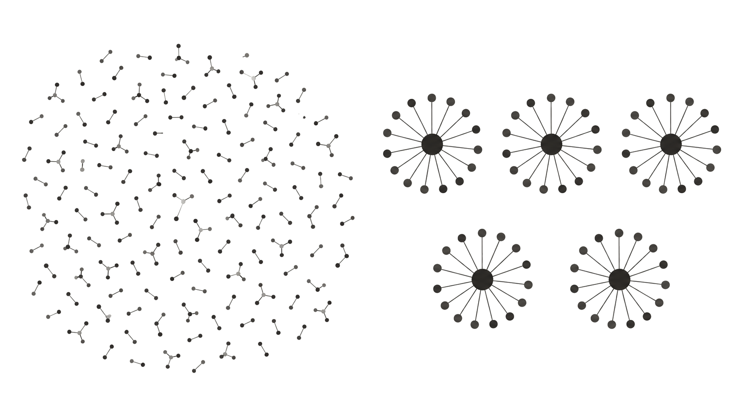

Notes:
TALK TRACK
• Targum is not the first Bible corpus; the difference is the unit of coverage.
• Earlier corpora maximize the number of languages represented.
• Targum selects English, French, Italian, Polish, and Spanish and asks how much translation history can be represented within each.
• Call this the choice between linguistic breadth and historical depth.
FULL NOTES
Earlier Bible corpora often maximize breadth: the number of languages
represented. Targum makes a different design choice. We selected English,
French, Italian, Polish, and Spanish and tried to represent more of the
translation history inside each of them.
The contrast is between linguistic breadth and historical depth. Retranslations,
revisions, and competing editions are not duplicate noise when translation
history is the object of study.
[Sources]
- /Users/mrapacz/pg/phd/manuscripts/dh2026-targum/1_Body.tex, Introduction and Related Work
- /Users/mrapacz/pg/phd/presentations/lrec2026/docs/transcript-clean.md, Introduction and motivation

Slide 3
New Testament Translations in Existing Corpora
Corpus
EN
FR
IT
PL
ES
Total
Christodouloupoulos & Steedman (2015)
2
1
1
1
1
6
eBible (Åkerman et al., 2023)
24
4
2
2
5
37
Mayer & Cysouw (2014)
39
17
7
6
22
91
Notes:
TALK TRACK
• Reuse the LREC comparison table across English, French, Italian, Polish, Spanish, and the total.
• Use the LREC labels “Targum” and “Targum unique”; introduce the corpus model only later.
• Compare 375 unique Targum texts with 91 versions in the largest prior corpus across these languages.
FULL NOTES
The largest prior Polish count in our comparison was six versions. Targum
represents twenty-nine Polish editions.
Prior resources and Targum do not use exactly the same identity grain, so this
is a comparison of represented coverage rather than a claim that every earlier
row maps neatly to one of our editions.
The important point is the amount of within-language variation available for
analysis.
[Sources]
- /Users/mrapacz/pg/phd/manuscripts/dh2026-targum/1_Body.tex, Comparative Depth, Table 2

Slide 4
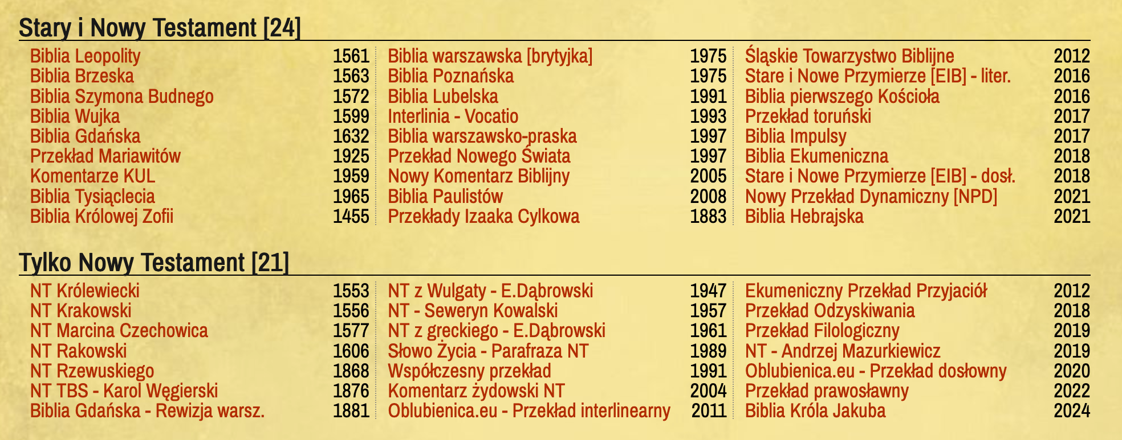
bibliepolskie.pl
https://bibliepolskie.pl/
Notes:
TALK TRACK
• Introduce bibliepolskie.pl as an index and reading interface for Polish Bible translations.
• Use it to distinguish documented translations from texts available for quantitative comparison.
FULL NOTES
Bibliepolskie.pl documents Polish Bible translations. It is a useful resource
for finding editions and, in some cases, reading them online.
The website is designed for readers. A comparative corpus needs a different
layer: stable identities, explicit edition boundaries, provenance, and
machine-readable texts.
[Sources]
- https://bibliepolskie.pl/
- /Users/mrapacz/pg/phd/presentations/lrec2026/presentation/assets/bibliepolskie-screenshot.png
- /Users/mrapacz/pg/phd/manuscripts/dh2026-targum/1_Body.tex, Comparative Depth

Slide 5
bibliepolskie.pl
https://bibliepolskie.pl/
45
New Testament translations listed
Notes:
TALK TRACK
• Reveal that the site lists 45 New Testament translations.
• Use the number to establish the depth of the documented Polish tradition.
FULL NOTES
At the time of the study, the website listed forty-five New Testament
translations.
That number tells us that the history is much deeper than one standard Polish
Bible. It does not yet tell us which texts are available or how the listed
translations relate to one another.
[Sources]
- https://bibliepolskie.pl/
- /Users/mrapacz/pg/phd/manuscripts/dh2026-targum/1_Body.tex, Comparative Depth

Slide 6
bibliepolskie.pl
https://bibliepolskie.pl/
45
New Testament translations listed
≈20
readable online
Notes:
TALK TRACK
• Reveal that around 20 can be read online.
• A qualitative researcher can inspect these texts directly; a quantitative researcher needs structured, machine-readable access.
FULL NOTES
Around twenty of the listed New Testament translations could be read online.
For manual reading, that is already substantial. For comparative research,
online availability is only the start: the texts still need to be collected,
identified, and related to editions and works.
[Sources]
- https://bibliepolskie.pl/
- /Users/mrapacz/pg/phd/manuscripts/dh2026-targum/1_Body.tex, Comparative Depth

Slide 7
New Testament Translations in Existing Corpora
Corpus
EN
FR
IT
PL
ES
Total
Christodouloupoulos & Steedman (2015)
2
1
1
1
1
6
eBible (Åkerman et al., 2023)
24
4
2
2
5
37
Mayer & Cysouw (2014)
39
17
7
6
22
91
Targum
413
81
34
78
106
712
Targum unique
211
43
17
44
60
375
vs. largest prior
5.4×
2.5×
2.4×
7.3×
2.7×
4.1×
Notes:
TALK TRACK
• Reuse the LREC comparison table across English, French, Italian, Polish, Spanish, and the total.
• Use the LREC labels “Targum” and “Targum unique”; introduce the corpus model only later.
• Compare 375 unique Targum texts with 91 versions in the largest prior corpus across these languages.
FULL NOTES
The largest prior Polish count in our comparison was six versions. Targum
represents twenty-nine Polish editions.
Prior resources and Targum do not use exactly the same identity grain, so this
is a comparison of represented coverage rather than a claim that every earlier
row maps neatly to one of our editions.
The important point is the amount of within-language variation available for
analysis.
[Sources]
- /Users/mrapacz/pg/phd/manuscripts/dh2026-targum/1_Body.tex, Comparative Depth, Table 2

Slide 8
Building the corpus from 15 sources
Source
EN
FR
IT
PL
ES
Total
bible.audio
3
15
0
0
1
19
bible.com
81
20
8
8
28
145
bible.is
21
9
1
2
15
48
biblegateway.com
64
4
5
3
19
95
biblehub.com
46
0
0
0
0
46
bibles.org
72
6
3
3
14
98
biblestudytools.com
37
0
0
0
0
37
biblia.info.pl
0
0
0
18
0
18
bibliepolskie.pl
0
0
0
20
0
20
crossbible.com
12
1
0
0
1
14
ebible.org
37
5
2
2
9
55
jw.org
1
1
1
1
1
5
laparola.net
9
3
11
0
2
25
obohu.cz
29
17
3
9
16
74
manually curated collection
1
0
0
12
0
13
Total
413
81
34
78
106
712
Notes:
TALK TRACK
• Explain that 712 source instances came from 15 source categories, including a manually curated collection.
• Name the mixture of language-specific repositories and international aggregators.
• Combining sources increases coverage but makes overlap unavoidable.
FULL NOTES
We collected six hundred and fifty-one source instances from thirteen source
libraries: twelve websites and the eBible corpus.
The same translation may occur on several sites. We keep the observed copies
until we can decide which edition and work each one represents.
No single source gave us the full collection. Combining sources increased
coverage, but it also multiplied labels, repeated texts, and source-specific
errors.
[Sources]
- /Users/mrapacz/pg/phd/manuscripts/dh2026-targum/1_Body.tex, Acquisition and Processing, Table 1
- /Users/mrapacz/pg/phd/targum/public/targum-corpus-public/manifest.json

Slide 9
The same translation across sources
bible.audio
King James
bible.com
King James Version
biblegateway.com
Authorized (King James) Version
biblehub.com
King James Bible
crossbible.com
KJV-1611 · KJV-1769
obohu.cz
King James Bible – Pure Cambridge Edition
Notes:
TALK TRACK
• Point out that the King James Version appears under several labels.
• Ask how many genuinely distinct translations or editions the 712 observed copies represent.
FULL NOTES
The King James Version appears under several names and on several sites.
CrossBible even distinguishes 1611 and 1769 in its labels.
At collection time, these labels are source claims. They do not by themselves
tell us whether two rows contain the same edition, different revisions of one
work, or a source-specific error.
Even this familiar name cannot be resolved reliably by string matching.
[Sources]
- /Users/mrapacz/pg/phd/targum/public/targum-corpus-public/instances.tsv, King James rows
- /Users/mrapacz/pg/phd/targum/packages/canon/src/canon/data/works/king-james-version.yaml

Slide 10
The same translation across sources
bible.audio
King James
use one source
bible.com
King James Version
biblegateway.com
Authorized (King James) Version
biblehub.com
King James Bible
crossbible.com
KJV-1611 · KJV-1769
obohu.cz
King James Bible – Pure Cambridge Edition
Notes:
TALK TRACK
• Present the first shortcut: keep one source.
• Explain that it avoids overlap by sacrificing the additional coverage gained from combining sources.
FULL NOTES
We could choose one source and discard the rest. That would hide disagreements
between sites and omit editions that appear only elsewhere.
[Sources]
- /Users/mrapacz/pg/phd/manuscripts/dh2026-targum/1_Body.tex, Canonicalization and Cross-Source Validation

Slide 11
The same translation across sources
bible.audio
King James
use one source
bible.com
King James Version
biblegateway.com
Authorized (King James) Version
filter by similarity
biblehub.com
King James Bible
crossbible.com
KJV-1611 · KJV-1769
obohu.cz
King James Bible – Pure Cambridge Edition
Notes:
TALK TRACK
• Present the second shortcut: remove texts above a similarity threshold.
• Explain that the threshold is necessarily a research decision about how much difference counts as uniqueness.
FULL NOTES
We could filter by lexical similarity. Similarity helps us find candidates, but
it cannot decide whether a small difference is a parser error, a source typo,
or a historical revision.
[Sources]
- /Users/mrapacz/pg/phd/manuscripts/dh2026-targum/1_Body.tex, Canonicalization and Cross-Source Validation

Slide 12
The same translation across sources
bible.audio
King James
use one source
bible.com
King James Version
biblegateway.com
Authorized (King James) Version
filter by similarity
biblehub.com
King James Bible
crossbible.com
KJV-1611 · KJV-1769
obohu.cz
King James Bible – Pure Cambridge Edition
Notes:
TALK TRACK
• Different researchers may want one representative KJV, several historical KJV editions, or the same edition as distributed by different sites.
• Filtering in advance would define uniqueness for those researchers.
• Retain the repetition because small changes and cross-source disagreements can themselves be evidence.
FULL NOTES
Both shortcuts decide what counts as a duplicate before the research begins.
They either remove source disagreement or collapse revisions because their
texts happen to be close.
[Sources]
- /Users/mrapacz/pg/phd/manuscripts/dh2026-targum/1_Body.tex, Canonicalization and Cross-Source Validation

Slide 13
The same translation across sources
bible.audio
King James
use one source
bible.com
King James Version
biblegateway.com
Authorized (King James) Version
filter by similarity
biblehub.com
King James Bible
crossbible.com
KJV-1611 · KJV-1769
annotate
obohu.cz
King James Bible – Pure Cambridge Edition
Notes:
TALK TRACK
• State the Targum response: retain every observed copy and annotate the edition and work it represents.
• Let users collapse the data to instances, editions, or works according to their question.
FULL NOTES
So we annotate the relationship. We retain the observed copy, identify its
edition, and connect that edition to a work.
[Sources]
- /Users/mrapacz/pg/phd/manuscripts/dh2026-targum/1_Body.tex, Canonicalization and Cross-Source Validation

Slide 14
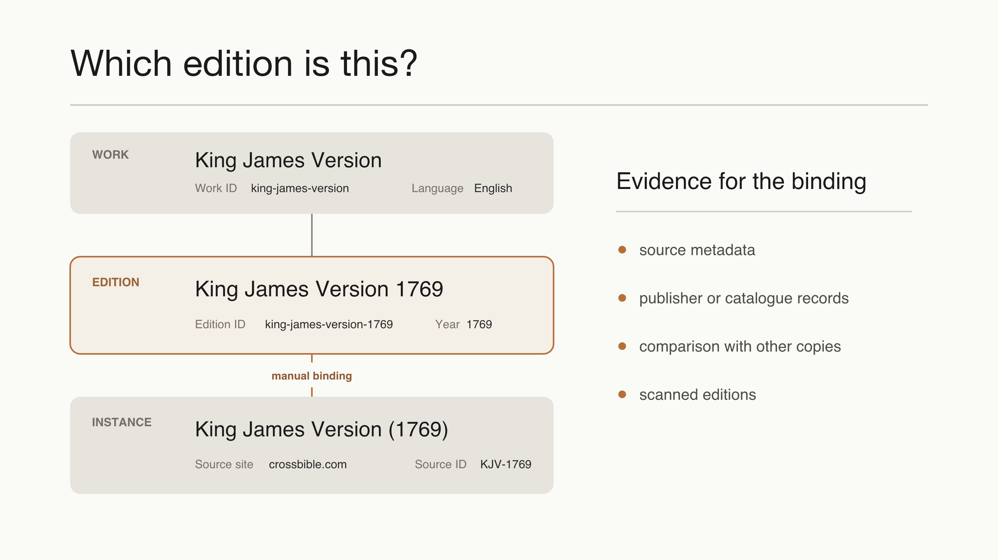
Which edition is this?
Notes:
TALK TRACK
• Walk through the KJV-1769 instance, curated edition, and King James Version work.
• Describe this as the most demanding part of the construction process: 712 instances were inspected and reconciled.
• Use website labels first, then publisher or catalogue records, comparison with already identified copies, and scanned historical editions.
• The result is a documented binding rather than an identity inferred from similarity alone.
FULL NOTES
CrossBible exposes an instance called KJV-1769. We retain its source identifier
and label, bind it to the curated edition king-james-version-1769, and connect
that edition to the King James Version work.
The site label is evidence, but it is not always sufficient. Across the corpus
we also consulted publisher pages, catalogues, secondary references, scanned
editions, and comparisons with other source copies.
The mapping is a research decision that can be inspected and corrected.
[Sources]
- /Users/mrapacz/pg/phd/targum/public/targum-corpus-public/instances.tsv, crossbible.com KJV-1769 row
- /Users/mrapacz/pg/phd/targum/packages/canon/src/canon/data/works/king-james-version.yaml

Slide 15
Corpus construction
Notes:
TALK TRACK
• Follow the main sequence: index, scrape, text review, annotate, validation.
• Treat parsing as part of scraping and text review, not as a separate visible stage.
• Text Review happens separately for each observed instance.
• Validation compares several instances and may send the process back to scraping or annotation.
• Unexpected differences may indicate scraping errors, incorrect annotations, or genuine source discrepancies.
• Similarity locates cases for inspection; it does not define identity automatically.
FULL NOTES
We first index the available translations. We then scrape and cache the texts,
including parsing, and review each observed instance before annotation.
Validation uses expected relationships between several instances as a reference
point. Unexpected differences can reveal a scraping problem, an incorrect
annotation, or a genuine discrepancy in the source texts.
Lexical similarity helps us locate cases for inspection, but it does not define
identity automatically.
[Sources]
- /Users/mrapacz/pg/phd/manuscripts/dh2026-targum/1_Body.tex, Acquisition and Processing, Canonicalization, and Cross-Source Validation

Slide 16
The corpus in numbers
1
corpus
Notes:
TALK TRACK
• Give the current counts: 712 instances, 375 editions, 235 works.
• Explain the hierarchy in one sentence: observed source copies map to editions, and editions map to works.
• Add the two edition-level annotations used in the talk: publication year and copyright status.
FULL NOTES
Targum is one corpus built around five languages. It currently contains two
hundred and thirty-five translation works, represented by three hundred and
seventy-five editions and seven hundred and twelve observed source instances.
An instance is the copy observed at one source, together with its edition
binding. At edition level, we provide a normalized display name, publication
year, copyright status, and work binding. At work level, we provide the
normalized translation name.
Researchers can choose the grain their question requires without silently
flattening one level into another.
[Sources]
- /Users/mrapacz/pg/phd/targum/public/targum-corpus-public/instances.tsv
- /Users/mrapacz/pg/phd/targum/public/targum-corpus-public/editions.tsv
- /Users/mrapacz/pg/phd/targum/public/targum-corpus-public/works.tsv

Slide 17
The corpus in numbers
1
corpus
5
languages
Notes:
TALK TRACK
• Give the current counts: 712 instances, 375 editions, 235 works.
• Explain the hierarchy in one sentence: observed source copies map to editions, and editions map to works.
• Add the two edition-level annotations used in the talk: publication year and copyright status.
FULL NOTES
Targum is one corpus built around five languages. It currently contains two
hundred and thirty-five translation works, represented by three hundred and
seventy-five editions and seven hundred and twelve observed source instances.
An instance is the copy observed at one source, together with its edition
binding. At edition level, we provide a normalized display name, publication
year, copyright status, and work binding. At work level, we provide the
normalized translation name.
Researchers can choose the grain their question requires without silently
flattening one level into another.
[Sources]
- /Users/mrapacz/pg/phd/targum/public/targum-corpus-public/instances.tsv
- /Users/mrapacz/pg/phd/targum/public/targum-corpus-public/editions.tsv
- /Users/mrapacz/pg/phd/targum/public/targum-corpus-public/works.tsv

Slide 18
The corpus in numbers
1
corpus
5
languages
235
works
Notes:
TALK TRACK
• Give the current counts: 712 instances, 375 editions, 235 works.
• Explain the hierarchy in one sentence: observed source copies map to editions, and editions map to works.
• Add the two edition-level annotations used in the talk: publication year and copyright status.
FULL NOTES
Targum is one corpus built around five languages. It currently contains two
hundred and thirty-five translation works, represented by three hundred and
seventy-five editions and seven hundred and twelve observed source instances.
An instance is the copy observed at one source, together with its edition
binding. At edition level, we provide a normalized display name, publication
year, copyright status, and work binding. At work level, we provide the
normalized translation name.
Researchers can choose the grain their question requires without silently
flattening one level into another.
[Sources]
- /Users/mrapacz/pg/phd/targum/public/targum-corpus-public/instances.tsv
- /Users/mrapacz/pg/phd/targum/public/targum-corpus-public/editions.tsv
- /Users/mrapacz/pg/phd/targum/public/targum-corpus-public/works.tsv

Slide 19
The corpus in numbers
1
corpus
5
languages
235
works
375
editions
Notes:
TALK TRACK
• Give the current counts: 712 instances, 375 editions, 235 works.
• Explain the hierarchy in one sentence: observed source copies map to editions, and editions map to works.
• Add the two edition-level annotations used in the talk: publication year and copyright status.
FULL NOTES
Targum is one corpus built around five languages. It currently contains two
hundred and thirty-five translation works, represented by three hundred and
seventy-five editions and seven hundred and twelve observed source instances.
An instance is the copy observed at one source, together with its edition
binding. At edition level, we provide a normalized display name, publication
year, copyright status, and work binding. At work level, we provide the
normalized translation name.
Researchers can choose the grain their question requires without silently
flattening one level into another.
[Sources]
- /Users/mrapacz/pg/phd/targum/public/targum-corpus-public/instances.tsv
- /Users/mrapacz/pg/phd/targum/public/targum-corpus-public/editions.tsv
- /Users/mrapacz/pg/phd/targum/public/targum-corpus-public/works.tsv

Slide 20
The corpus in numbers
1
corpus
5
languages
235
works
375
editions
712
instances
Notes:
TALK TRACK
• Give the current counts: 712 instances, 375 editions, 235 works.
• Explain the hierarchy in one sentence: observed source copies map to editions, and editions map to works.
• Add the two edition-level annotations used in the talk: publication year and copyright status.
FULL NOTES
Targum is one corpus built around five languages. It currently contains two
hundred and thirty-five translation works, represented by three hundred and
seventy-five editions and seven hundred and twelve observed source instances.
An instance is the copy observed at one source, together with its edition
binding. At edition level, we provide a normalized display name, publication
year, copyright status, and work binding. At work level, we provide the
normalized translation name.
Researchers can choose the grain their question requires without silently
flattening one level into another.
[Sources]
- /Users/mrapacz/pg/phd/targum/public/targum-corpus-public/instances.tsv
- /Users/mrapacz/pg/phd/targum/public/targum-corpus-public/editions.tsv
- /Users/mrapacz/pg/phd/targum/public/targum-corpus-public/works.tsv

Slide 21
Editions per work
162
45
14
4
6
4
1
2
3
4
5
6+
editions per work
Notes:
TALK TRACK
• Most works have one represented edition: 162 of 235.
• The remainder have two, three, or more represented editions; a few have six or more.
• The histogram shows why work and edition cannot be treated as interchangeable counts.
FULL NOTES
Most works have only one represented edition: one hundred and sixty-five of
two hundred and twenty-three.
The remaining works have two, three, or more represented editions, and a few
have six or more. The histogram makes the distinction between a translation
work and a published edition visible rather than collapsing both into one
count.
[Sources]
- /Users/mrapacz/pg/phd/targum/interfaces/viewer/public/data/landing.json, stats.editionHist

Slide 22
Copyright status by language
Public domain
Open license
Copyrighted
English
70
28
113
n=211
Spanish
9
8
43
n=60
French
19
2
22
n=43
Polish
10
5
29
n=44
Italian
7
10
n=17
Notes:
TALK TRACK
• Copyright status is a coarse edition-level annotation: public domain, open license, or copyrighted.
• Roughly 40% of editions are marked public domain or openly licensed; roughly 60% are copyrighted.
• The distinction determines which texts can be redistributed openly, while all editions remain represented in the metadata.
• Modern copyrighted translations are part of the historical coverage that public-domain-only corpora tend to omit.
FULL NOTES
Copyright status is a coarse edition-level annotation: public domain, open
license, or copyrighted.
Roughly forty percent of the editions are marked as public domain or openly
licensed, while roughly sixty percent are copyrighted. The proportions vary
across languages.
This distinction determines which texts can be redistributed openly. All
editions remain represented in the metadata, including modern copyrighted
translations that public-domain-only collections tend to omit.
[Sources]
- /Users/mrapacz/pg/phd/targum/interfaces/viewer/public/data/landing.json, stats.copyrightByLang

Slide 23
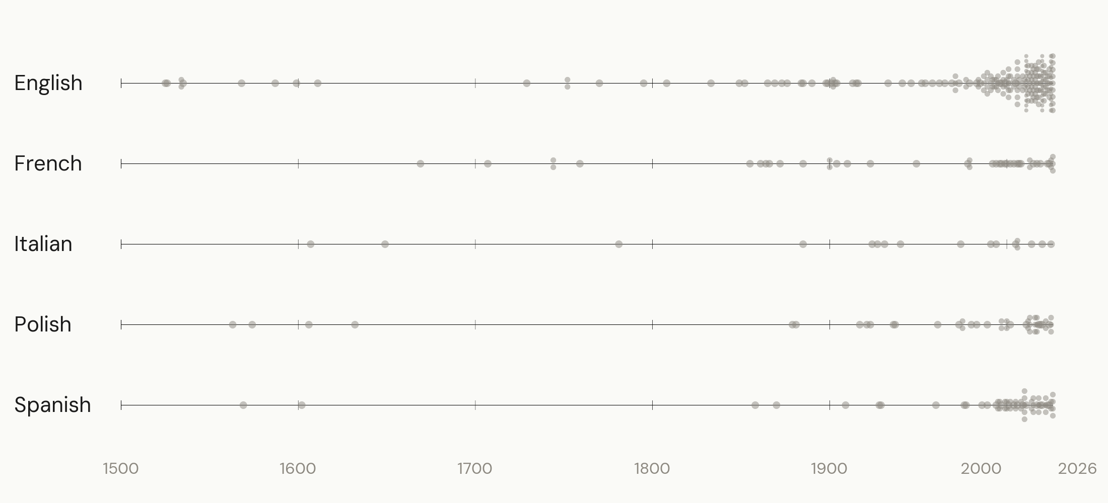
A diachronic view
Notes:
TALK TRACK
• Each dot is one edition; same-year editions are stacked.
• The represented years run from 1525 to 2026.
• The continuous spread shows that New Testament translation is an ongoing practice, not a single historical event.
• Frame the density as corpus coverage shaped by publication, survival, digitization, access, and curation.
FULL NOTES
At edition level, represented publication years run from 1525 to 2026.
Each dot is one edition. Where several editions share a publication year, the
dots are stacked so that the amount of represented material remains visible.
The spread shows that New Testament translation is an ongoing practice rather
than a single historical event. This remains a coverage plot: publication,
survival, digitisation, access, and curation all affect its density.
[Sources]
- /Users/mrapacz/pg/phd/targum/public/targum-corpus-public/manifest.json, year_range
- /Users/mrapacz/pg/phd/manuscripts/dh2026-targum/1_Body.tex, Diachronic Distribution

Slide 24
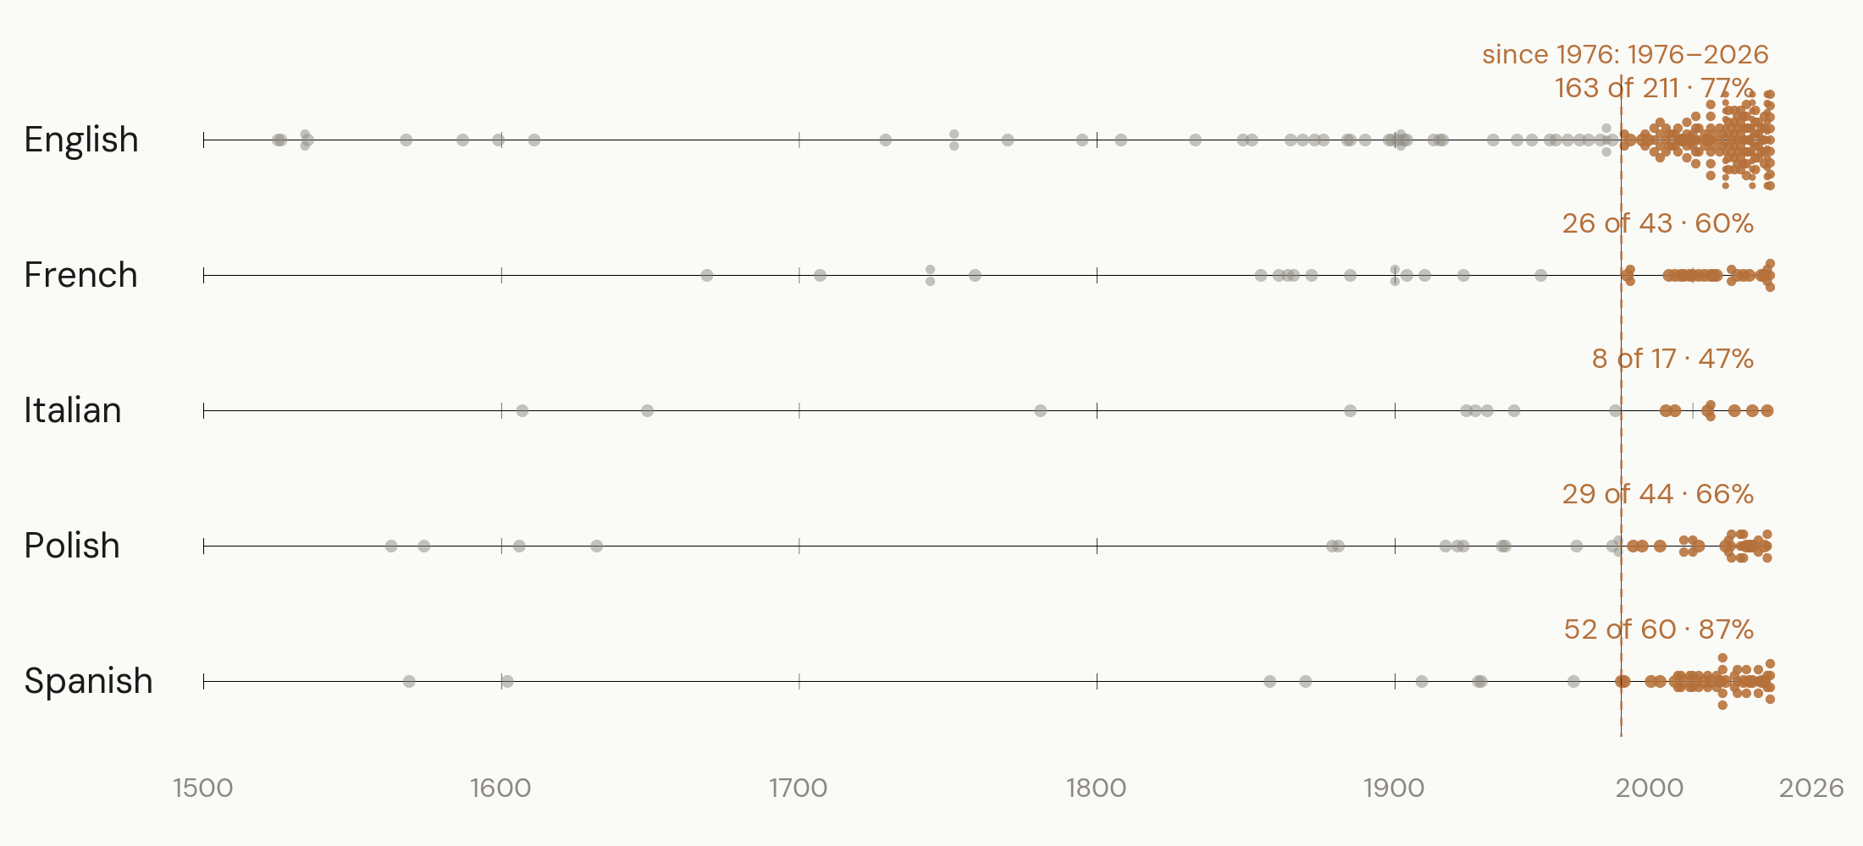
Editions published since 1976
Notes:
TALK TRACK
• Between 47% and 83% of the represented editions in each language were published in the last fifty years.
• Use this to show how strongly the corpus represents contemporary translation practice.
• Do not turn corpus density into a direct publication-frequency claim; recent material is also easier to digitize and collect.
FULL NOTES
When we highlight editions published in the last fifty years, the modern
concentration becomes clear. Depending on the language, between forty-seven
and eighty-three percent of the represented editions fall in this period.
This gives us substantial material for comparing contemporary translation
practice. It does not by itself show that publication frequency increased:
recent editions are also more likely to survive digitally, remain online, and
appear in the sources we collected.
[Sources]
- /Users/mrapacz/pg/phd/manuscripts/dh2026-targum/1_Body.tex, Diachronic Distribution
- Current edition-level plotting data

Slide 25
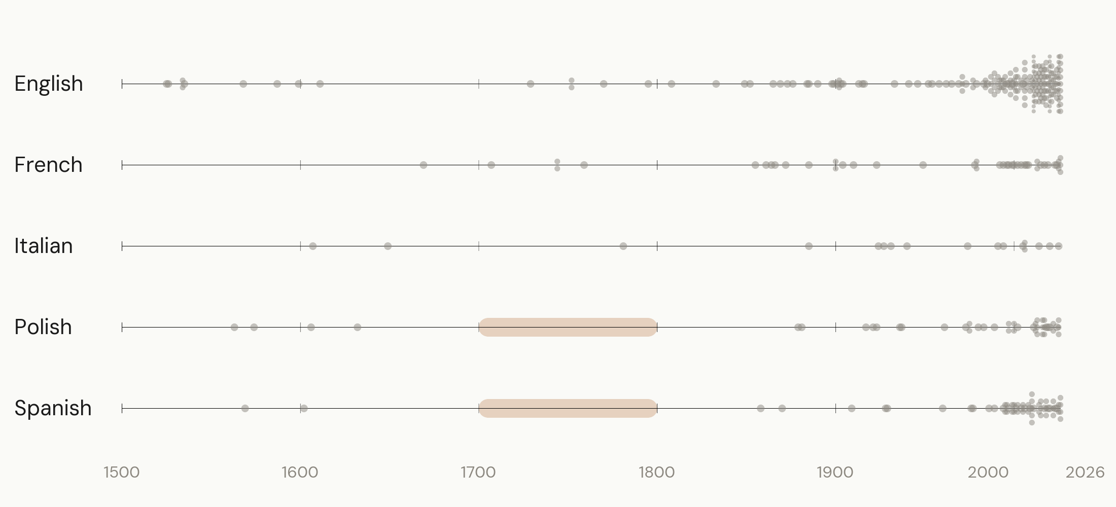
The eighteenth century
Notes:
TALK TRACK
• Point out the lack of represented Polish and Spanish editions in the eighteenth century.
• Explain that the bibliographic checking behind the accepted study found reprints but no newly translated works in those intervals.
• Present this as a supported historical interpretation, while acknowledging that corpus construction can never prove absolute absence.
FULL NOTES
The Polish and Spanish rows contain no represented eighteenth-century editions.
The bibliographic checking behind the accepted study suggests that these gaps
reflect the translation history rather than a scraping omission: the period
contains reprints of earlier works, but no newly translated works that we could
identify.
Corpus construction cannot prove absolute absence, but the interpretation is
based on evidence beyond this plot.
[Sources]
- /Users/mrapacz/pg/phd/manuscripts/dh2026-targum/1_Body.tex, Diachronic Distribution

Slide 26
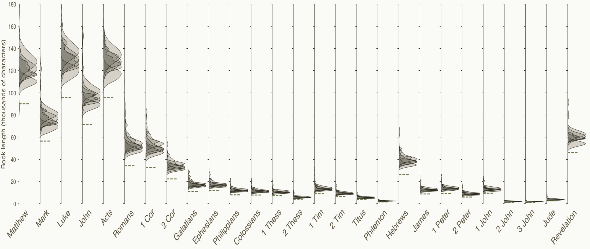
Book lengths across the New Testament
Notes:
TALK TRACK
• Orient the audience to the 27 New Testament books and their different absolute lengths.
• Point out the longer narrative books, shorter epistles, and Revelation at the end.
• The Ancient Greek reference is shorter than the translations across the books; describe this as consistent with cross-linguistic expansion, not proof of one cause.
• Show that editions also vary within each book before collapsing the distributions by language.
FULL NOTES
The corpus lets us compare book lengths across editions.
The full distribution follows the structure of the New Testament: the Gospels
and Acts are longer narrative books, most epistles are shorter, and Revelation
is long again.
The Ancient Greek reference is shorter than the translations across the books.
That is consistent with cross-linguistic expansion from a highly inflected
source language, although the figure does not establish one cause.
The spread within each book shows that editions do not occupy exactly the same
amount of text.
[Sources]
- /Users/mrapacz/pg/phd/presentations/lrec2026/docs/transcript-clean.md, Book-length distribution
- /Users/mrapacz/pg/phd/presentations/lrec2026/presentation/figures/book_length_ridgeline.pdf

Slide 27
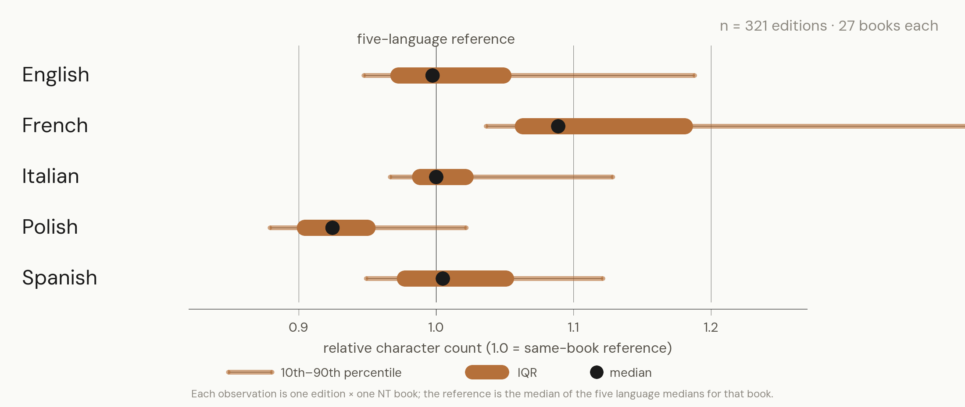
Translation length by language
Notes:
TALK TRACK
• Explain the marks: thin line is the 10th–90th percentile, thick box is the IQR, black dot is the median.
• French editions tend toward the longer end; Polish editions tend toward the shorter end.
• The earlier Bonferroni-corrected Mann–Whitney analysis supports the French–Polish contrast; do not imply that every language pair differs significantly.
• French articles and prepositions and Polish inflection are plausible linguistic explanations, not effects established by this plot.
• Character length does not directly measure literalness, translation strategy, or quality.
FULL NOTES
Across the twenty-seven books, French editions tend toward the longer end and
Polish editions toward the shorter end.
The earlier Bonferroni-corrected Mann–Whitney analysis supports the
French–Polish contrast. It does not show that every pair of languages differs.
French articles and prepositions and Polish inflection are plausible
linguistic explanations. Character count can also reflect orthography and
translation choices, so this plot does not identify one cause or measure
literalness, strategy, or quality.
[Sources]
- /Users/mrapacz/pg/phd/presentations/lrec2026/docs/transcript-clean.md, Book-length distribution
- /Users/mrapacz/pg/phd/presentations/ipipan-2026-06/scripts/generate_figures.py, collect_book_lengths
- /Users/mrapacz/pg/phd/targum/scripts/lrec_data_extraction.py, write_data_book_lengths
- /Users/mrapacz/pg/phd/targum/docs/ai-logs/2026-03-16-lrec-paper-audit.log.md, Mann-Whitney U tests

Slide 28
What’s available
GitHub
Hugging Face
metadata
redistributable texts
verse and chapter embeddings
pairwise similarity
targum.net
corpus explorer
Notes:
TALK TRACK
• GitHub provides complete metadata and the texts that can be redistributed.
• Hugging Face adds verse- and chapter-level embeddings and precomputed lexical and semantic similarity.
• If derived representations are sufficient for a research question, they permit analysis without redistributing copyrighted text.
• Targum.net provides the interactive corpus explorer.
FULL NOTES
The GitHub repository contains the metadata tables and texts that can be
redistributed.
Hugging Face adds verse- and chapter-level embeddings and precomputed lexical
and semantic similarity.
If these derived representations are sufficient for a research question, they
allow analysis without redistributing copyrighted text. The underlying texts
remain subject to their legal status.
Targum.net provides an interface for reading, browsing, and comparing the same
corpus.
[Sources]
- https://github.com/mrapacz/targum-corpus
- https://huggingface.co/datasets/mrapacz/targum-corpus
- https://targum.net/
- /Users/mrapacz/pg/phd/targum/public/targum-corpus-public/README.md

Slide 29
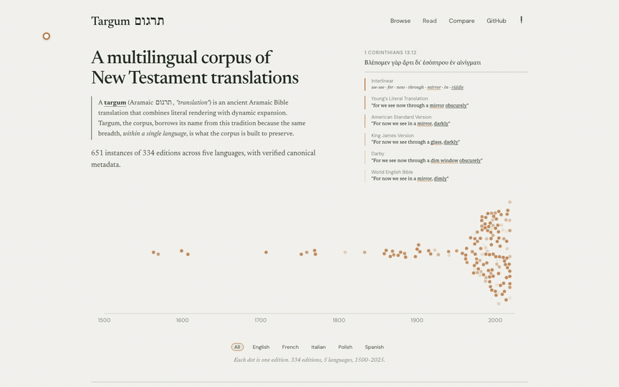
targum.net — corpus explorer
Notes:
TALK TRACK
• Introduce the interface as the entry point for qualitative interaction informed by corpus-level statistics.
• Show how the landing page presents the corpus and routes to its resources.
FULL NOTES
Since the accepted submission, we have built targum.net as a place for
qualitative interaction with the translations while keeping corpus-level
statistics and metadata available.
The landing page introduces the corpus and points to its public routes and
downloads.
[Sources]
- https://targum.net/
- /Users/mrapacz/pg/phd/presentations/dh2026-targum/assets/targum/site/landing-interaction.gif

Slide 30
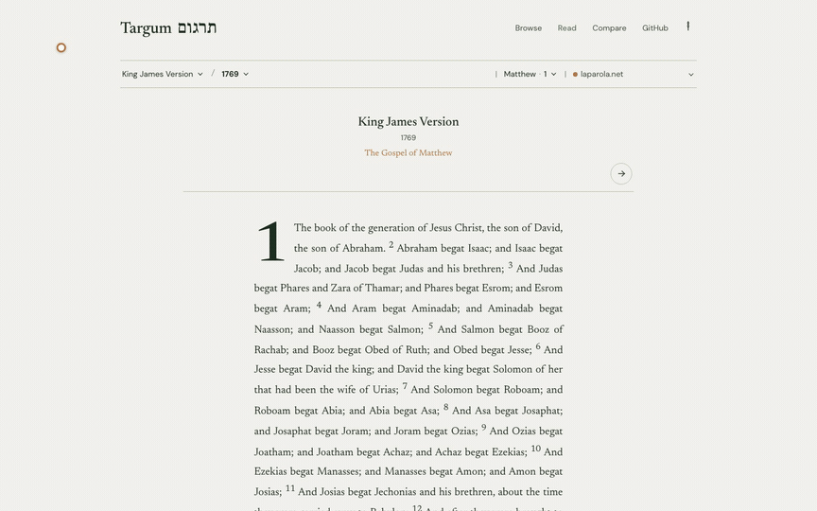
targum.net — read translations
Notes:
TALK TRACK
• Read begins from a named edition rather than an anonymous text file.
• Point out the visible language, work, edition, book, chapter, and source context.
• Demonstrate moving through the text.
FULL NOTES
Read starts from an edition rather than an anonymous text file. The interface
keeps the language, work, edition, book, chapter, and source visible beside the
text.
[Sources]
- https://targum.net/read
- /Users/mrapacz/pg/phd/presentations/dh2026-targum/assets/targum/site/read-interaction.gif

Slide 31
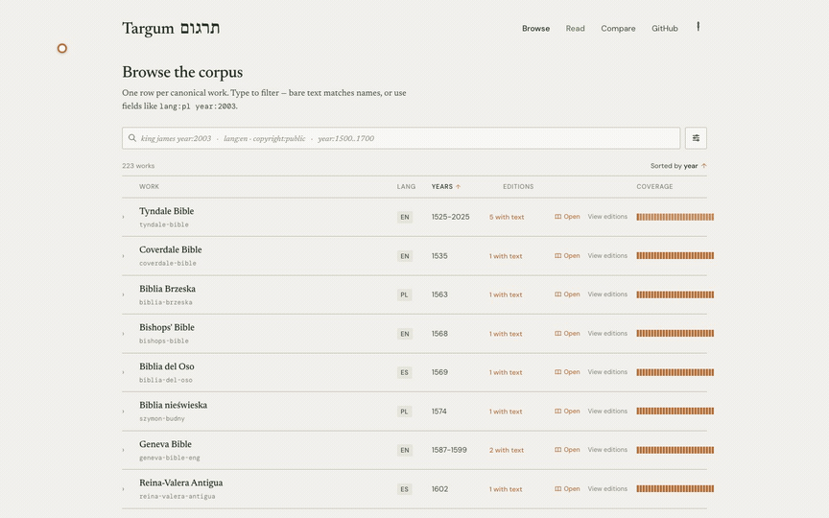
targum.net — browse the corpus
Notes:
TALK TRACK
• Browse exposes works, editions, source instances, publication years, and copyright metadata.
• Demonstrate filtering rather than reconstructing the hierarchy from filenames.
FULL NOTES
Browse makes the work, edition, and source-instance relationships inspectable.
It also exposes publication and copyright metadata without requiring a
researcher to reconstruct the hierarchy from filenames.
[Sources]
- https://targum.net/browse
- /Users/mrapacz/pg/phd/presentations/dh2026-targum/assets/targum/site/browse-interaction.gif

Slide 32
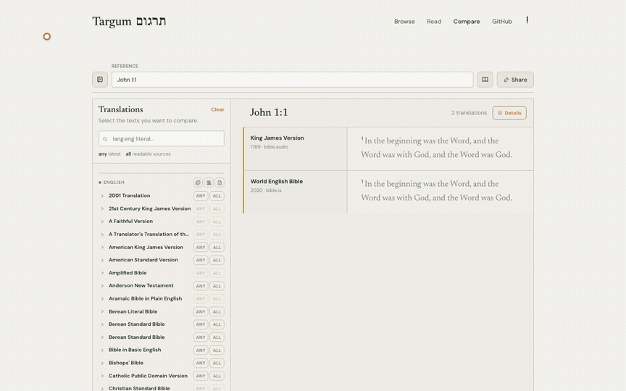
targum.net — compare translations
Notes:
TALK TRACK
• Select named editions and place their text side by side.
• The comparison interface uses the same identity model as the downloadable corpus.
FULL NOTES
Where both texts are included, Compare places two named editions side by side.
Reading, browsing, and comparison therefore follow the same
instance–edition–work model as the downloadable data.
[Sources]
- https://targum.net/compare
- /Users/mrapacz/pg/phd/presentations/dh2026-targum/assets/targum/site/compare-interaction.gif

Slide 33
Next steps
Confessional tradition
Source text
Relationships
Catholic
Protestant
Orthodox
Ecumenical
Critical text
Textus Receptus
Byzantine / Majority text
revision of
derived from
related to
Notes:
TALK TRACK
• Add explicitly declared confessional tradition without assigning one when the sources do not.
• Record which Greek critical edition, manuscript tradition, or intermediary source text an edition used.
• Connect works through revision, derivation, and other historical relationships.
• The longer-term goal is a map of how translation works and interpretive choices develop across editions and lineages.
FULL NOTES
The next metadata layer concerns confessional tradition, the source text used
by an edition, and relationships between translation works.
Confessional tradition should record explicit declarations rather than assign
an identity when the sources do not. Source-text metadata should distinguish
critical editions, manuscript traditions, and translations produced through
an intermediary text such as Latin.
Relationships are needed because work boundaries alone do not describe the
history. A translation may revise, derive from, or otherwise build on another
work even when their names differ. The longer-term goal is to map those
lineages and test whether interpretive choices can be traced across them.
Most of these annotations are still ongoing and are not part of the corpus we
have presented today.
We do not claim to have captured the history of New Testament translation. We
hope that distinguishing observed copies, editions, and works moves us one step
closer and enables research that a flat collection cannot.
[Sources]
- /Users/mrapacz/pg/phd/targum-worktrees/targum-wt-canon-studio-mvp/packages/canon/src/canon/data/taxonomy/tags.yaml
- /Users/mrapacz/pg/phd/targum-worktrees/targum-wt-canon-studio-mvp/packages/canon/src/canon/models.py, Relationship

Slide 34
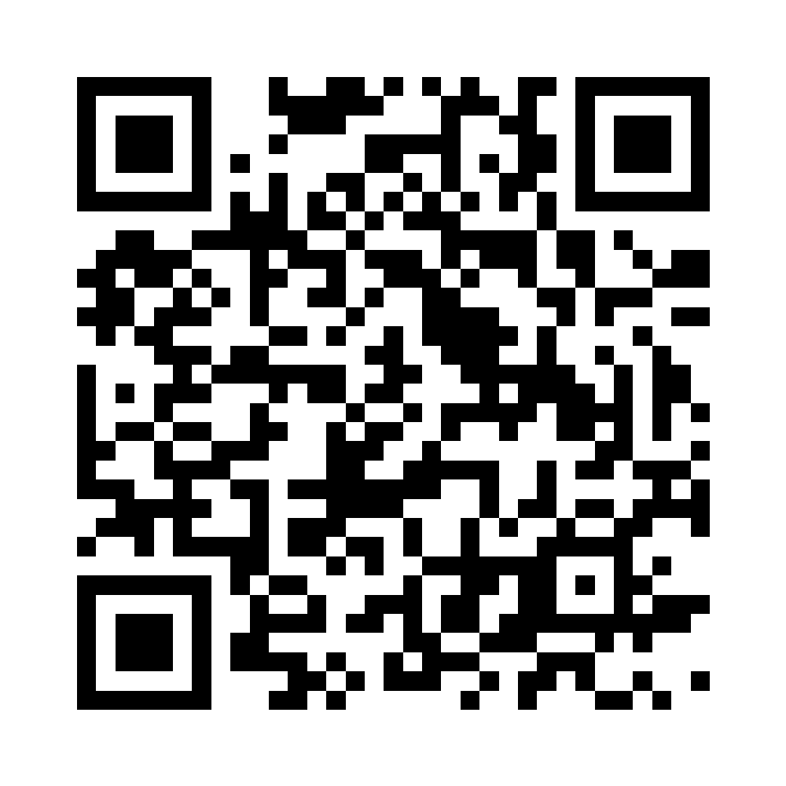
targum.net
mrapacz.com/eadh2026
The research was supported by the National Science Centre, Poland under project no. 2025/57/N/HS2/04961.
We acknowledge Polish high-performance computing infrastructure PLGrid (HPC Center: ACK Cyfronet AGH) for computer facilities and support within computational grant no. PLG/2026/019145.
Notes:
TALK TRACK
• Return to the opening contrast: Targum trades linguistic breadth for greater depth within five languages.
• Do not claim that the corpus captures the complete translation history of these languages.
• Present it as one step toward a digital resource that represents that history closely enough to support new questions.
• Point to the QR code for the corpus, downloads, explorer, and EADH materials.
FULL NOTES
We do not claim that Targum captures the complete history of New Testament
translation in these languages. We hope it is one step toward a digital
resource that represents that history closely enough to support questions a
flat collection cannot.
The corpus, downloads, viewer, and conference materials are available through
this QR code. Thank you.
[Sources]
- https://mrapacz.com/eadh2026/
- /Users/mrapacz/pg/phd/presentations/eadh2026-targum/assets/targum/eadh2026-qr.png
- /Users/mrapacz/pg/phd/presentations/eadh2026-targum/assets/targum/targum-dotted-taw.png
- /Users/mrapacz/pg/phd/presentations/ipipan-2026-06/presentation/slides/24-thanks.typ
- /Users/mrapacz/pg/phd/manuscripts/eadh2026-interlinear-baselines/1_Body.tex, acknowledgements

Slide 35
What Wikipedia says about translation strategy
223
118
85
76
→
→
→
works in audit
Wikipedia-linked
direct work pages
works with explicit evidence
Rendering orientation
Language, style & accessibility
Revision operation
n = 60 explicit findings
n = 33 explicit findings
n = 22 explicit findings
Formal equivalence
16
Not normalized
9
Textual revision
10
Literal
13
Literary
7
Editorial modernization
9
Dynamic equivalence
10
Simplified language
7
Readability revision
3
Mixed
7
Accessible reading level
2
Generally literal
3
Gender-inclusive
2
Paraphrase
3
Contemporary vernacular
2
Not normalized
3
Amplification
1
Optimal equivalence
2
Latinate
1
Closest natural equivalence
1
Oral storytelling
1
Literal–idiomatic
1
Source-feature explication
1
Free translation
1
Direct Wikipedia pages, explicit statements only · 36 works span multiple dimensions
Notes:
TALK TRACK
• Appendix only: this is an evidence audit, not a corpus-wide strategy distribution.
• In the frozen 223-work audit snapshot, 118 have Wikipedia relations; 85 are direct translation pages; 76 contain explicit evidence.
• Count only explicit statements, never classifications inferred from source language, affiliation, or general praise.
• Keep rendering orientation, language/style/accessibility, and revision operation separate.
• Thirty-six works contribute to more than one dimension, so the three distributions are not mutually exclusive.
• Preserve overlapping labels such as literal, generally literal, and formal equivalence until the taxonomy is better justified.
FULL NOTES
This is an appendix view, not a claim about the distribution of translation
strategies across the whole corpus.
Of 223 works in the audit snapshot, 118 have at least one Wikipedia relation. Eighty-five of those
relations lead to a page directly about the translation or revision rather
than a biography, translation list, or broader family. Seventy-six direct
pages contain at least one explicit statement about strategy, style, or a
revision operation.
We did not infer a strategy from source language, translator identity,
affiliation, or general claims of accuracy. The distributions include only
explicit wording.
The evidence separates into three dimensions: how the translation relates
source and target text; its language, style, or accessibility policy; and the
operation performed when revising an earlier translation. Thirty-six works
contain evidence in more than one dimension, so these counts are findings, not
mutually exclusive work categories.
The labels are deliberately not over-normalized. For example, literal,
generally literal, and formal equivalence remain separate because Wikipedia
does not use them consistently. This is why the result is useful as an
evidence audit, but not yet as final corpus metadata.
[Sources]
- /Users/mrapacz/pg/phd/targum-worktrees/targum-wt-wikipedia-approach-pilot/docs/research/canon-wikipedia-approach-audit/aggregate.yaml
- /Users/mrapacz/pg/phd/targum-worktrees/targum-wt-wikipedia-approach-pilot/docs/research/canon-wikipedia-approach-audit/summary.md
- /Users/mrapacz/pg/phd/targum-worktrees/targum-wt-wikipedia-approach-pilot/docs/research/canon-wikipedia-approach-audit/README.md
- /Users/mrapacz/pg/phd/targum-worktrees/targum-wt-wikipedia-approach-pilot, commit fda6f4c1

Slide 36
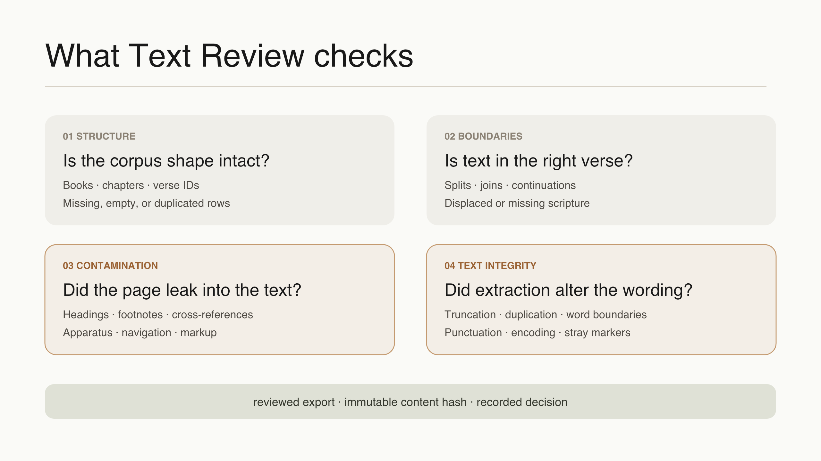
Notes:
TALK TRACK
• Text Review checks structure, verse boundaries, contamination by editorial material, and the integrity of the extracted text.
• Each accepted export is tied to an immutable content hash, so the reviewed text state remains auditable.
FULL NOTES
None
[Sources]

Slide 37
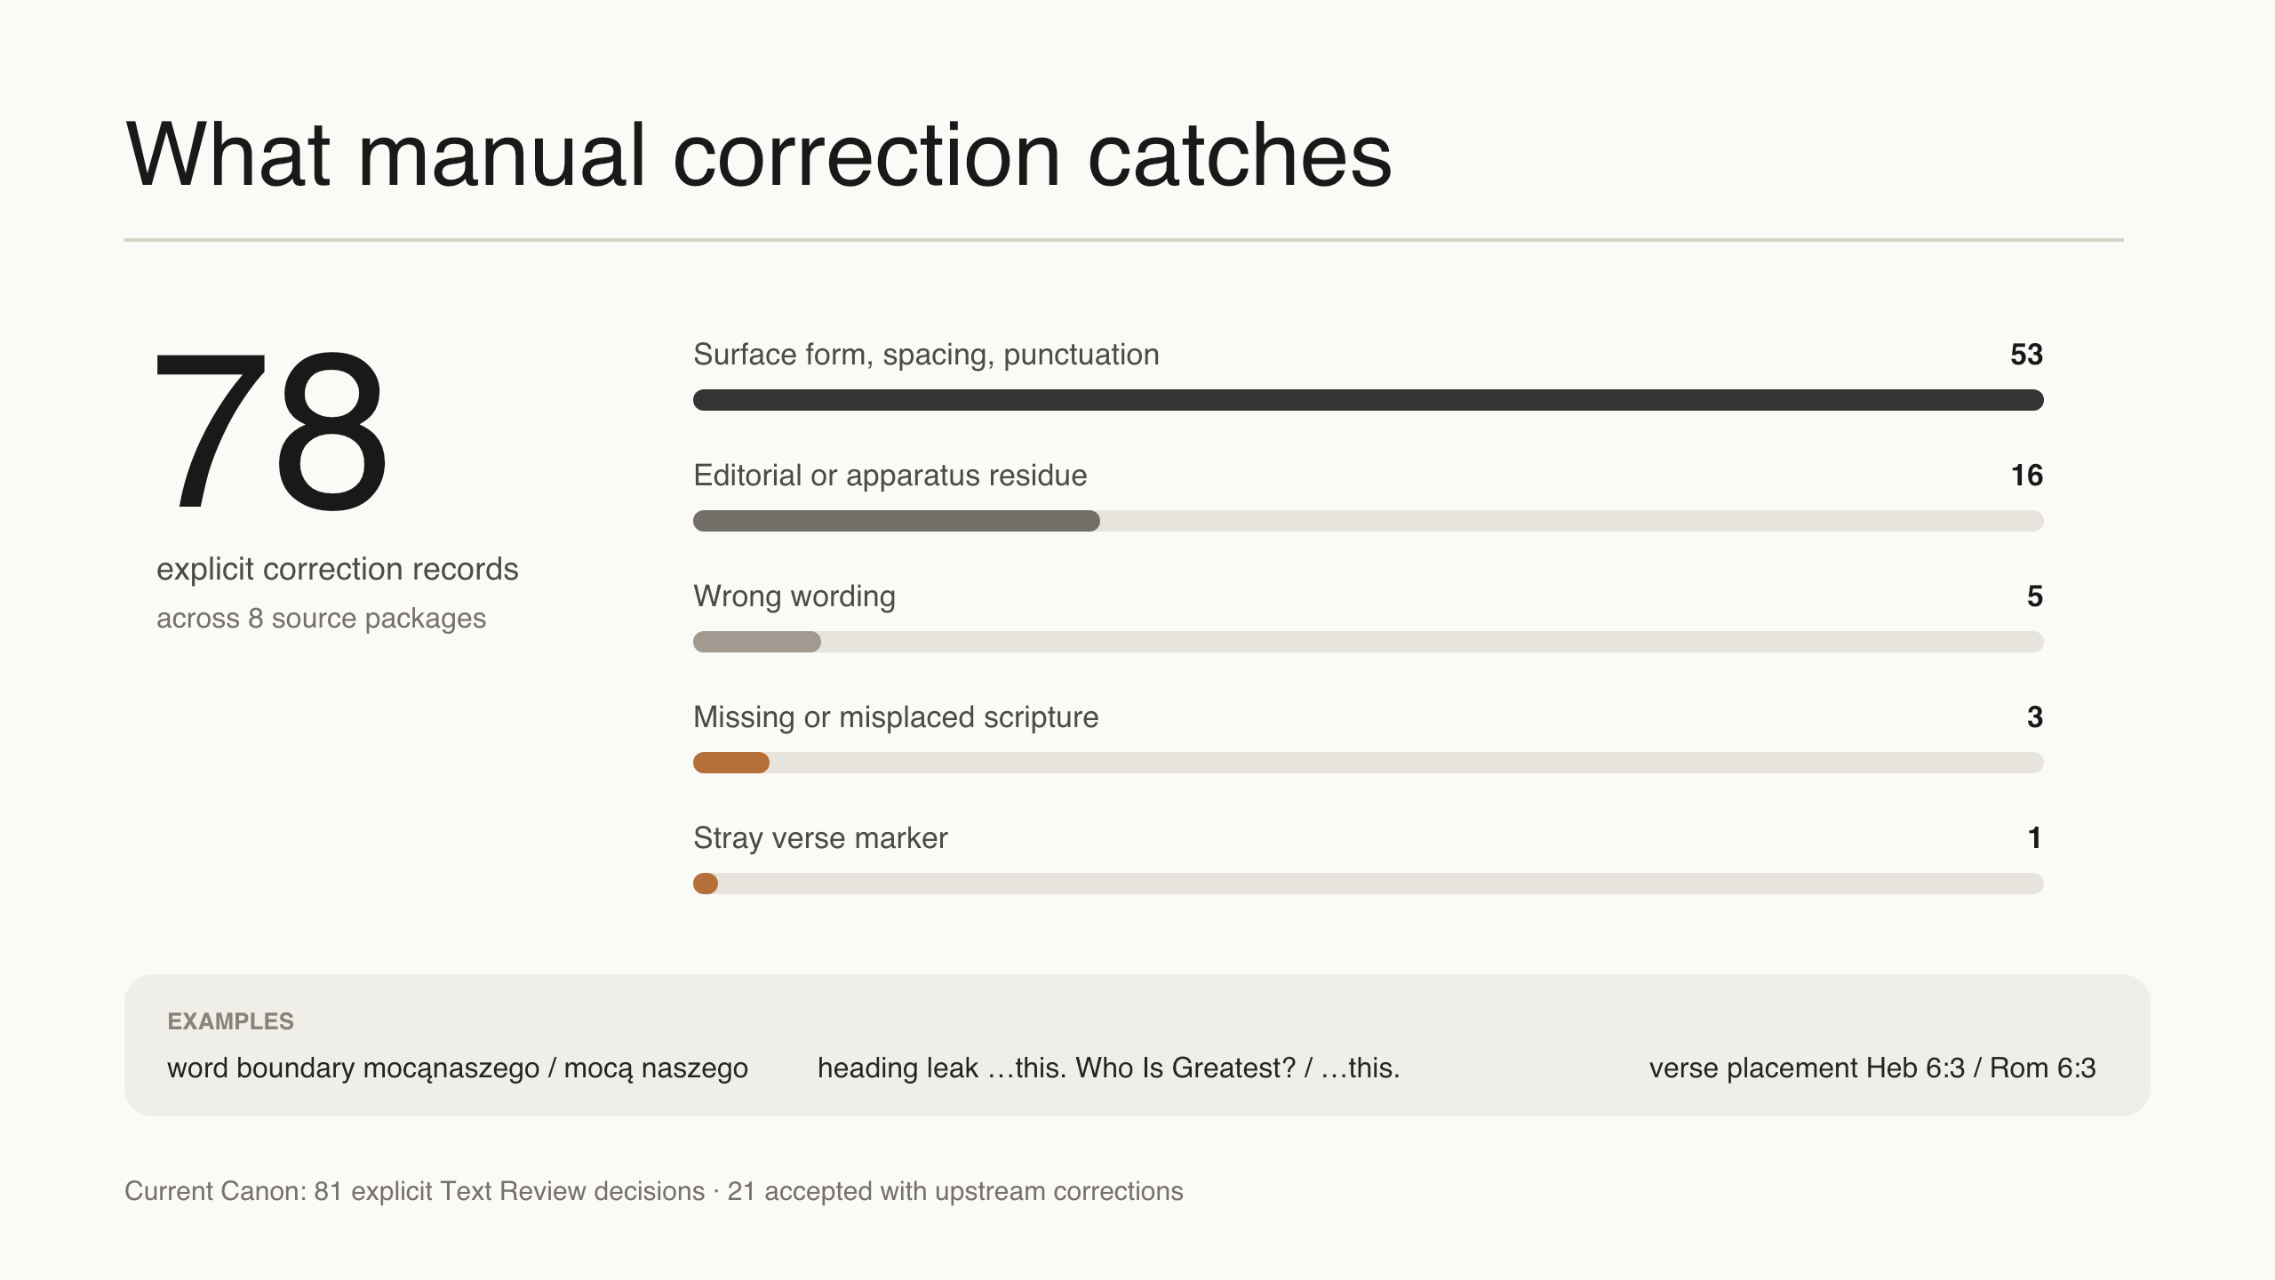
Notes:
TALK TRACK
• The current Canon records 81 explicit Text Review decisions and 78 explicit upstream-correction records across eight source packages.
• For this presentation, those 78 records were classified into surface-form repairs, editorial or apparatus residue, wrong wording, missing or misplaced scripture, and stray verse markers.
FULL NOTES
None
[Sources]

